Slide 1
Cloudera Data Platform(CDP) Overview
Notes:
Welcome to today Partner SkillUP.
Today we’ll be giving an overview of the Cloudera Data Platform.

Slide 2
Agenda
Enabling Modern Data Architectures
CDP Public Cloud
CDP Private Cloud
Demo

Slide 3
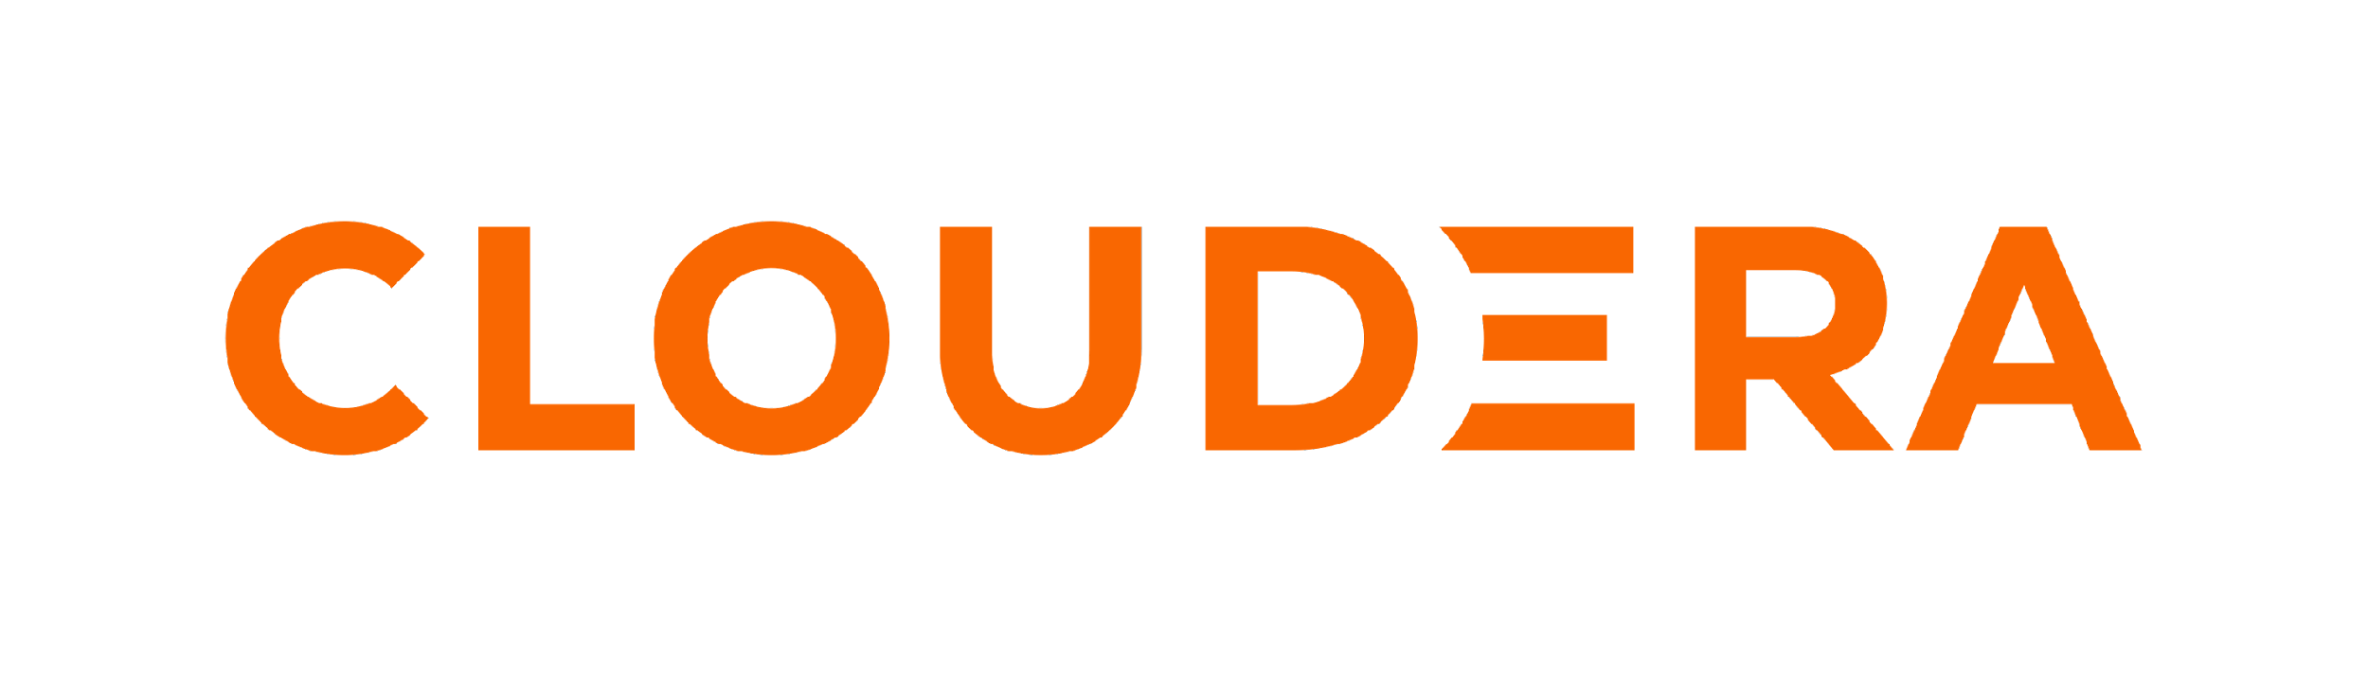
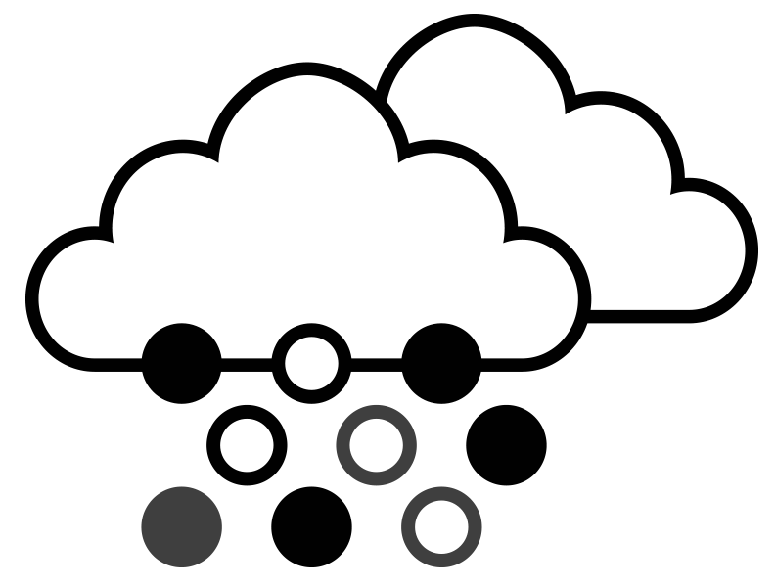
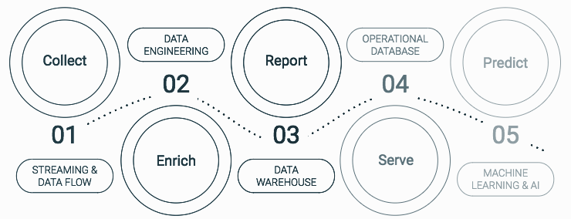
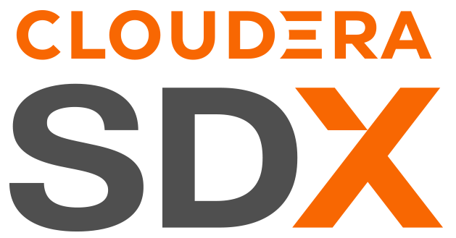

THE ENTERPRISE DATA CLOUD COMPANY
Any Cloud
Data Lifecycle
Secure & Governed
Open
Notes:
So first let’s talk about how Cloudera is different from ALL other vendors.
For that we have the four key PILLARS.
First, other vendors lack multi-cloud, or data center capabilities
Cloudera offers Hybrid and multiple public cloud capabilities to give your clients MAX choice and FLEXIBILITY
Where you can Move data and apps without rewriting and retraining
We separate data management from the infrastructure strategy
And you can Manage all environments from a single pane of glass
Second, other vendors lack multi-function, or lack integration between functions
With Cloudera, you deploy one platform to address current and future workload needs
You can connect disparate workloads to develop Edge2AI apps ON one platform!
Next, Cloudera SDX - No one else comes close to SDX – It provides security and governance across any cloud and data center; it has all functions to secure and keep secure, AUTOMATICALLY
You can Manage data security and governance centrally
It Automates app security at all layers
It helps you Shorten time to value with enterprise productivity tools
Lastly, no other vender is proven 100% open source for all this functionality – all our software is contributed upstream under the Apache of AGPL licenses; our binaries require subscription ala Red Hat
This reduces vendor lock-in with a 100% open source platform
You can also extend the enterprise data cloud architecture with 3rd party apps

Slide 4
ENABLING MODERN DATA ARCHITECTURES
Notes:
Given our unique platform capabilities, we feel we’re positioned to best enable Modern Data Architectures.
So when we say Modern Data Architectures, what are talking about?
[CLICK]

Slide 5
CLOUDERA’S HYBRID DATA PLATFORM–
ENABLING MODERN DATA ARCHITECTURES
DATA LAKE
DATA FABRIC
DATA LAKEHOUSE
DATA MESH
Notes:
OK….So, when we talk about modern data architectures
You’re moving from Data Lake to a Data Fabric, Data Lakehouse, and finally Data Mesh
A Data Fabric is essentially orchestrating disparate data sources intelligently and securely, and managing them
With Data Lakehouse
Gartner’s definition of a Data Lakehouse is that it integrates and unifies the capabilities of data warehouses and data lakes,
and critically important for the definition, is that it supports “multifunction analytics” on a single platform.
With Data Mesh you have Distributed data products oriented around domains and owned by
independent cross-functional teams, using a common data infrastructure as a platform
to host, prep and serve their data assets.
What Cloudera has built over the last few years, is a platform that has all the building blocks to enable these modern data architectures
Now competitors may talk about doing data mesh, building lakehouses and so on,
But nobody is positioned to do it in a hybrid, multi-cloud, on-premise world…… like we are.

Slide 6
CLOUDERA DATA PLATFORM - ENABLING MODERN DATA ARCHITECTURES
Data Mesh | Data Applications
Distributed data products oriented around domains and owned by independent cross-functional teams who have embedded data engineers and data product owners, using common data infrastructure as a platform to host, prep and serve their data assets.
Data Lakehouse | Multi-Function Analytics
Integrates and unifies the capabilities of data warehouses and data lakes, aiming to support AI, BI, ML and data engineering (“multifunction analytics”) on a the same data set
Data Ingestion
Data Transformation
Data Warehousing
Streaming Analytics
Machine Learning
Data Fabric | Orchestration
Dynamically orchestrating disparate data sources intelligently and securely in a self-service manner, leveraging data platforms to deliver integrated and trusted data to support various applications, analytics and other workloads
Data Catalog
Security, Governance and Lineage
Observability
Replication
Hybrid & Multi-Cloud: consistent experience across all environments
Hybrid On-premise Data Center & Multi-Cloud Platforms
Public
Cloud
Private Cloud
Notes:
Let’s talk a little bit about modern data architectures. The industry is standardizing around three terms: Data fabrics, data lakehouses, and data mesh. The reality is that Cloudera has been delivering data fabrics and data lake houses for a very long time, we just haven’t used those terminologies until now.
Data Fabric is simply the orchestration of governance around a distributed data platform which is something that we've done for many years.
Data Lakehouse layers on top of that multifunction analytics which we've also been delivering for 5+ years.
Data mesh is an interesting and emerging data architecture construct. The idea is to allow businesses to have data as a product so they can make and serve their own data platforms which are then integrated with other data platforms both internally and externally as data services.
We have customers already building data meshes today and are talking about it publicly. Customers like HelloFresh and UniCredit, but this is an area that you are going to see a lot more focus and investment on as we move forward, but it's important to note that we are uniquely positioned to deliver this in a hybrid fashion which is critical to the data mesh vision. [CLICK]
.

Slide 7
the hybrid data company
We believe that data can make what is impossible today, possible tomorrow
We empower people to transform complex data anywhere into actionable insights faster and easier
We deliver a hybrid data platform with secure data management and portable cloud-native data analytics
Notes:
Now, as a Company, our Vision has not changed.
We still believe that DATA can make what is impossible today, possible tomorrow
We still want to empower people to transform complex data anywhere into actionable insights faster and easier
And do this by delivering a hybrid data platform with secure data management and portable cloud-native data analytics

Slide 8
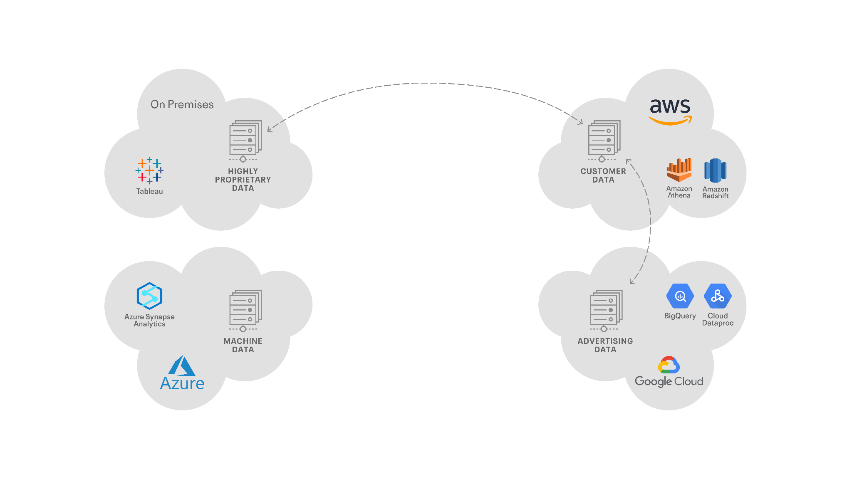
DISTRIBUTED DATA MANAGEMENT COMPONENTS
Which may run on multiple clouds and/or on-premises
OZONE
S3
ADLS
GCS
Notes:
OK…
If we take a look at what a customer environment looks like today….
You’ve got… On-Premise data centers, obviously…With highly proprietary data sets running there
They may have Amazon data centers running customer data there
And maybe using tools like Athena and Redshift
They may also be using Google for advertising data…
Using Google Native tools like BigQuery and Cloud Dataproc
Or Have machine data in Azure,... and using Azure Synapse
And ofcourse they have a need, certainly, to sync this data across there clouds….
But managing this is extremely difficult, if not impossible
[CLICK]

Slide 9
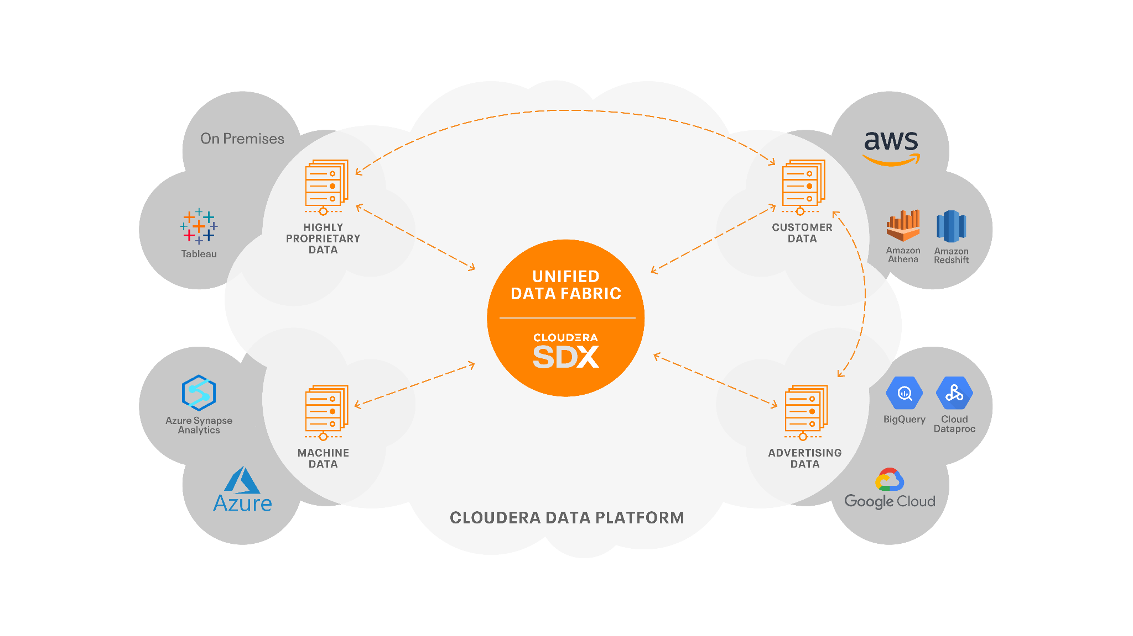
CLOUDERA’S HYBRID DATA PLATFORM
Portable. Interoperable. Open. Secure.
Notes:
What they need is a Unified Data Fabric!
And that’s where our Hybrid Data Platform, CDP comes in play
Cloudera’s SDX, CDP, really forms this Unified Data Fabric
Which allows us to let the customer run their data at the right place at the right time
It Allows you to manage the replication, governance, and security of that data
To see how the data is being used, what is being used, and have a catalog of it…….
And this is, this is the kind of core needed to bring this into a unified world
The key thing to point out here…. is.. when you have data in AWS, that data sets in S3, when its in Google Cloud, its sits in Google storage, and when it resides in Azure its in ADLS. We don’t lock that data, you can continue to use Cloud services to interact with that data.
Now once you have your data, you want to able to work with it
[CLICK]

Slide 10
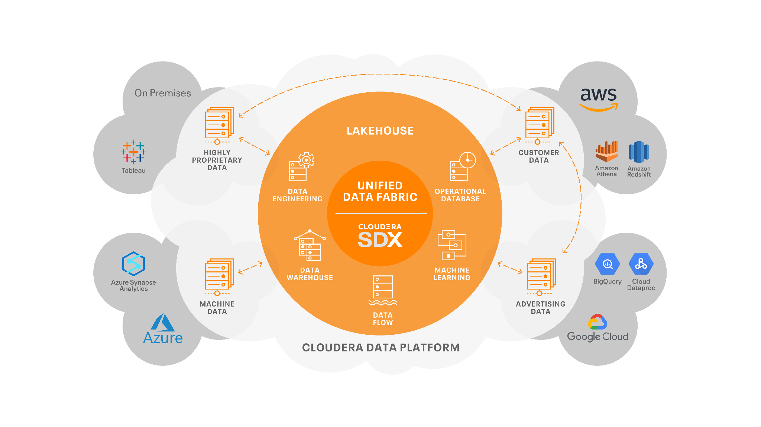
CLOUDERA’S HYBRID DATA PLATFORM
Portable. Interoperable. Open. Secure.
OZONE
S3
OPEN DATA
ADLS
GCS
Notes:
That’s where the Data Lakehouse concept comes in.
Sure you can use Cloud specific services to work with the data.
But with Cloudera, you can start running Data Services on top of that.
With our portable data services, you can run the same service on-prem, as in AWS, as in Google, as in Azure
And this really forms the open data lakehouse your clients need
This is what Cloudera’s Hybrid Data Platform can you do
It enables modern data architectures
So….What we have today, what we’ve been building
Is The Hybrid Data Platform that the industry needs
They need a platform that enables Modern Data architectures
Whether its data fabric, whether its a lakehouse, whether its data mesh or any future architecture of tomorrow
We have a platform that’s uniquely positioned to build upon and deliver today’s and the future’s modern data architectures
…..
Now let's take a closer look at the platform
[CLICK]

Slide 11
ANALYTICS ACROSS THE DATA LIFECYCLE
DATA ENGINEERING
MACHINE LEARNING
INGEST
ANALYZE
PUBLISH
02
04
01
03
05
PREPARE
PREDICT
STREAMING & DATA FLOW
DATA WAREHOUSE & OP DATABASE
OP DATABASE, VISUALIZATION
SECURITY | GOVERNANCE | LINEAGE | MANAGEMENT | AUTOMATION
Notes:
When we talk about our data platform, we like to show the Data Lifecycle.
We know when you’re working with data you first need to INGEST it.
For that we provide services to ingest streaming and batch data using our Streaming and Data Flow services.
You next need to PREPARE or curate that data.
And For that, we have Cloudera Data Engineering, powered by Spark, Flink, and Airflow
Once you have data you’ll want to ANALYZE it.
And you can do that with Cloudera Data Warehouse and our Operational Database
Once you analyze the data, you want to use it to PREDICT,.... and for that we have Cloudera Machine Learning.
And finally PUBLISH, You can visualize the data using our data visualization.
Through each one of these phases of the data life cycle, ..You have Cloudera SDX managing security, governance and data lineage…automatically
That’s pretty cool..
[CLICK]

Slide 12
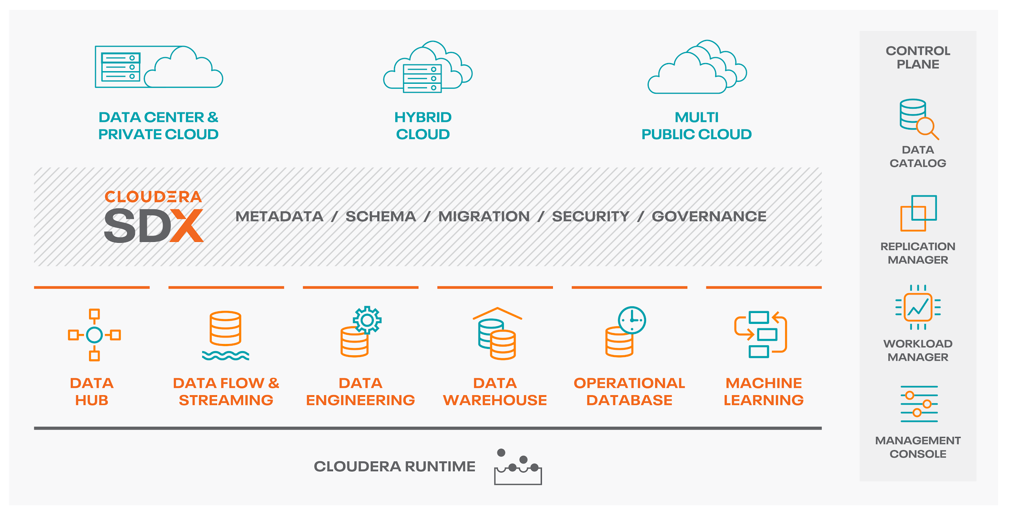
CLOUDERA DATA PLATFORM
View one pane of glass across hybrid and multi-clouds
Scale to petabytes of data and 1,000s of diverse users
Control cloud costs with auto scale, suspend and resume
Optimize workloads based on analytics and machine learning
Inspect data lineage across clouds and clusters
altus
data plane service
Notes:
So what do you get with the Cloudera Data Platform?
First, you can manage all your environments from a single pane of glass, across private cloud, an multi-clouds
You can scale to petabytes of data, You can control costs with autoscale and suspend functionality
You can optimize workloads based on analytics and machine learning.
And you’re able to inspect data lineage across clouds and clusters.
[CLICK]

Slide 13
CLOUDERA BUSINESS VALUE
Empowering people to transform complex data into clear and actionable insights
FASTER TIME TO VALUE
BETTER TCO/ROI
ONE PLATFORM
UNLIMITED UTILITY
2X
60%
1
Increased
user productivity
Higher ROI
versus competition
One Data Cloud
for Business & IT
Notes:
When it comes to business value
Because we have an integrated platform, you get 2 times increased user productivity,
That means faster time to value for your customers,
which means… you can start working on the next use case sooner.
60% better TCO/ROI that comes from People, operational savings, not just technology
One Platform, Unlimited Utility - That gives you a simplified architecture…..
[CLICK]

Slide 14
HOW DO CUSTOMERS USE CLOUDERA?
Every business use case is a data lifecycle use case
BANKING
Fraud detection
Anti-money laundering
Spend analytics
TECHNOLOGY
Customer analytics
Threat detection
Predictive support
TELCO
Churn analysis
Customer care
Network optimization
LIFE SCIENCES
Patient care (IoT)
Genomics research
Regulatory compliance
MANUFACTURING
Predictive maintenance (IoT)
Supply chain optimization
Remote monitoring
USE CASES
Barclays
Citi
Santander UK
Cisco
Intel
Reef Technology
Globe Telecom
Deutsche Telecom
Robi Axiata
GlaxoSmithKline
Clearsense
Cerner
Navistar
Micron
Sikorsky
KEY
CUSTOMERS
Notes:
So how are our customers using Cloudera?
In Banking, we have customers using us for Fraud Detection.
In Technology, we have customers doing Predictive Support
Telco uses us heavily for Network optimization.
Life Sciences, for Patient care and monitor the IOT medical devices like glucose meters
And finally Manufacturing companies use us for Remote monitoring of facilities or manufacturing processes
[CLICK]

Slide 15
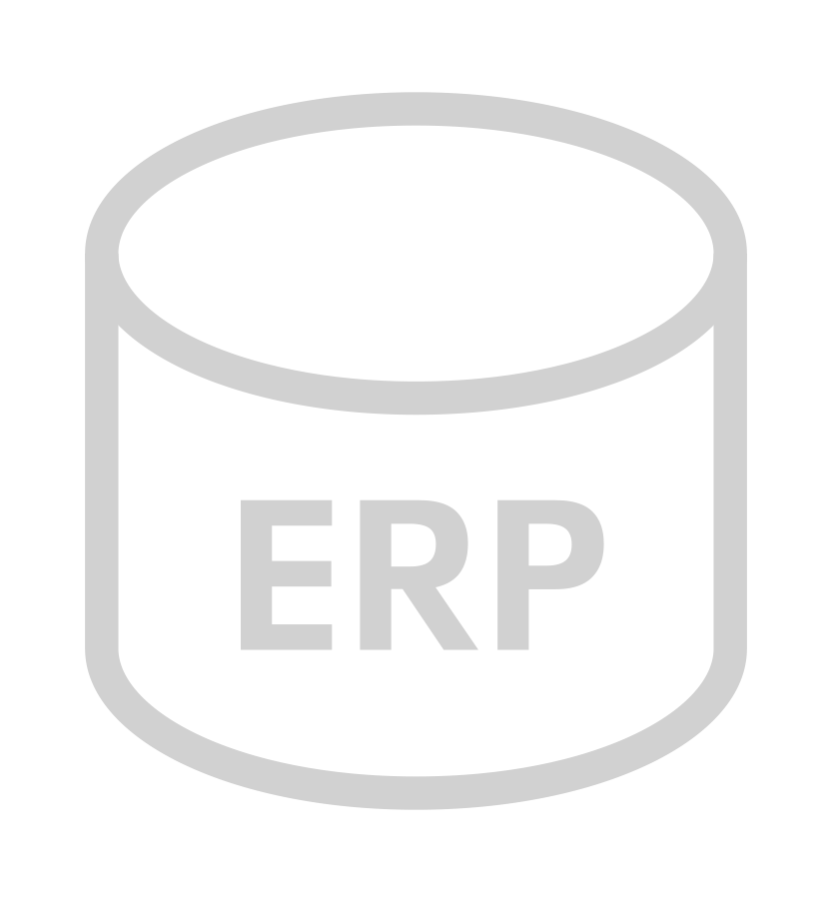
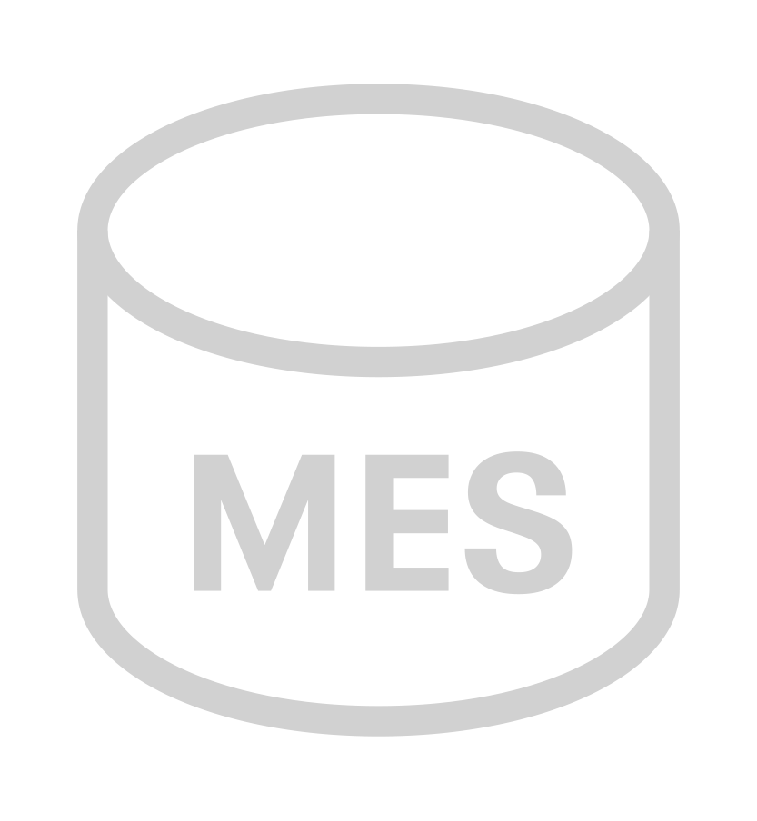
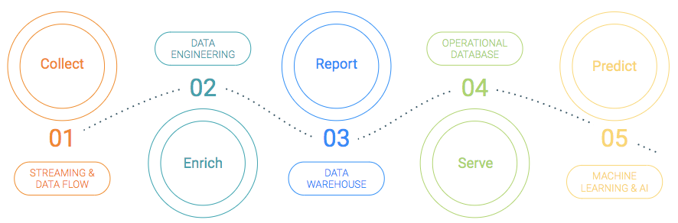


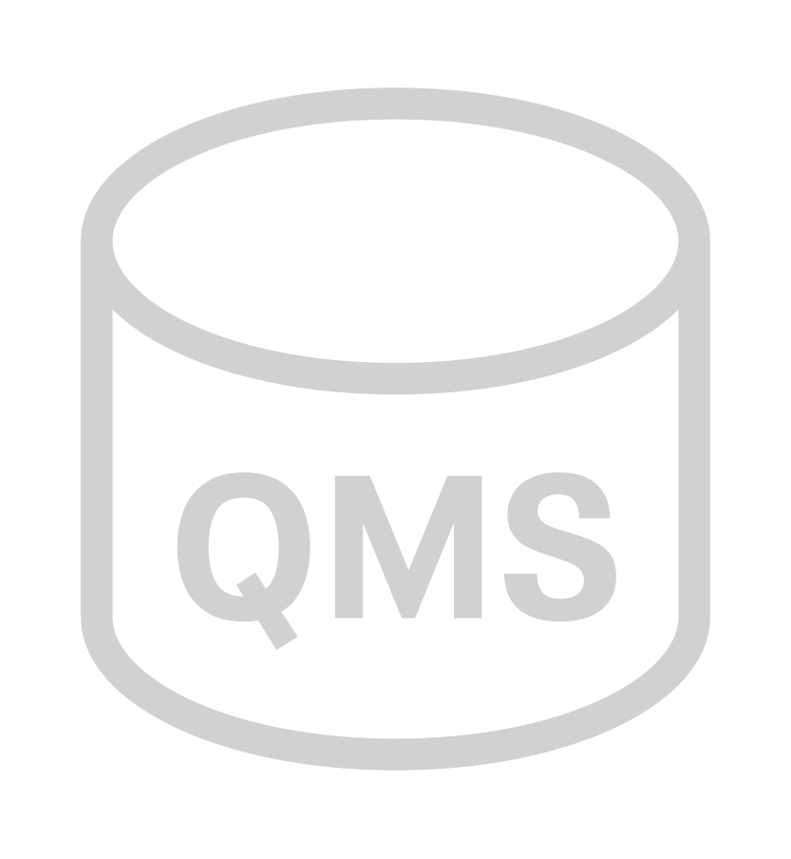
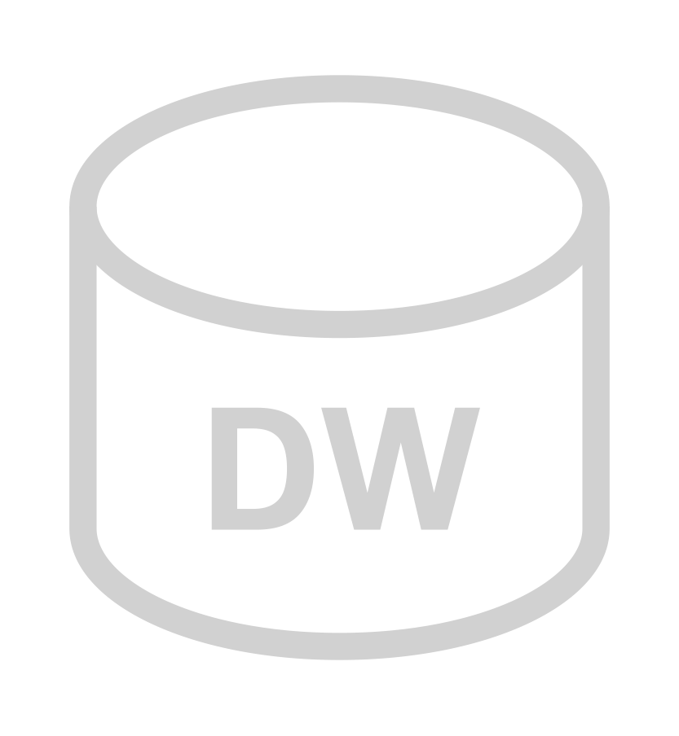

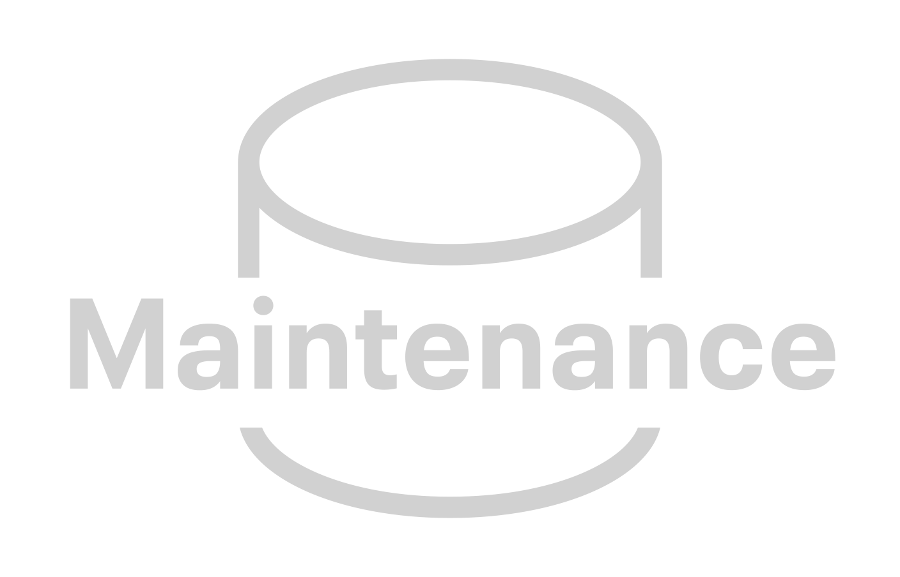


BUSINESS USE CASES REQUIRE THE DATA LIFECYCLE
An integrated lifecycle is easier to use, manage and secure
ENTERPRISE DATA
ENTERPRISE DATA CLOUD
ENTERPRISE USE CASES
REAL-TIME & TRANSACTIONAL
DATA LIFECYCLE
USE CASES
CONNECTED
PRODUCTION
CONNECTED PRODUCTS
PROCESS MONITORING DASHBOARDS
PREDICTIVE MAINTENANCE
SUPPLY CHAIN OPTIMIZATION
CONNECTED SUPPLY CHAIN
CONNECTED CONSUMER
THROUGHPUT OPTIMIZATION
COMPUTER VISION FOR QA
SECURITY | GOVERNANCE | LINEAGE | MANAGEMENT | AUTOMATION
Notes:
So what we’ve have learned with our customers,... is that every business use case needs multiple data and analytic functions to process diverse enterprise data - the data lifecycle.
Getting value from data is complex – because the data is complex, its distributed and rapidly changing – especially with more and more IoT data…
This slide is a MANUFACTURING example, but it shows you how the lifecycle can support every business use case...
connected data (IoT data) and transactional data, all needing to be processed rapidly to drive useful insights - supporting the USE CASES the business needs to implement…
[CLICK]

Slide 16
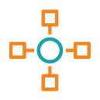
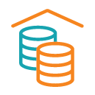
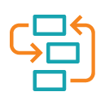
ONE PLATFORM – TWO FORM FACTORS
CDP Public Cloud
(platform-as-a-service)
CDP Private Cloud
(platform as installable software)
Control Plane
AWS
Azure
GCP
Bare Metal
Container Cloud
Traditional Workloads
Self-Serve Analytics
Traditional Workloads
Self-Serve Analytics
Data Hub Servers
DW, ML, DE, … Containers
Data Hub Servers
DW, ML, DE, … Containers
Cloudera Runtime
Notes:
CDP comes in two form factors
CDP Public Cloud and CDP Private Cloud
CDP Public Cloud runs on AWS, Azure, and GCP while CDP Private Cloud runs on Bare Metal and Kubernetes Containers
The key thing to point out is we have a Single Control Plane, SDX and Cloudera Runtimes that span both form factors.
Ok so First, I’m going to cover the CDP Public Cloud……

Slide 17
CDP PUBLIC CLOUD

Slide 18
WHY PUBLIC CLOUD?
Retirement of Legacy
Pricing Model
Enhanced Workload Elasticity
Greater Scalability
Increased Agility
Speed of Deployment
LOBs cannot wait
Cloud Mandates
IT Misses SLAs
Notes:
So why Public Cloud?
Well, the customer can’t wait, they want Increased Agility and Speed of Deployment,
Next, well customers have been mandated to use the Public Cloud, because legacy infrastructure is being retired, and of course they want to move to a different pricing model.
They also want to stop missing SLAs… They need enhance workload elasticity and greater scalability.
So how does CDP help?
[CLICK]

Slide 19
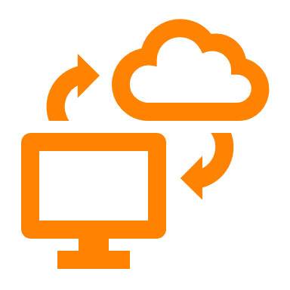

BENEFITS OF CDP PUBLIC CLOUD
Simplify Data Analytics
You Own Your Data
First Class Security
Hybrid Flexibility
Common Skill Set
Data Lifecycle
Easy and Portable
Notes:
Well, first CDP is PaaS offering……a Platform as a Service offering:
CDP is an automated PaaS platform
It offers Pain free automated deployment and destruction of secured clusters integrated with your environment
It Significantly reduces admin overheads with automation and governance tooling
Patching / Upgrades and enhancements are all done by Cloudera
It supports No lock-step upgrades - which means, multiple versions running at once in different clusters
Data in your VPC:
All data stays in your customer VPC - this is a theme because it is not the case with competition
We never move it or touch it !
One data set for all functions on the platform - no data silos
Customer Owns the relationship with cloud vendor
Integrated security
Consistent Security and Governance
You Set once at an environment level, inherited by all use cases.
Its Fully integrated and out of the box
Hybrid Flexibility:
You get the same Cloudera Runtime on-prem and in the cloud
You can Move the workloads that are right for cloud
Deliver onprem capability via Private cloud
This Gives you flexibility and choice
You Can start developing and testing in the cloud, and bring it back on prem later if needed - same tech everywhere
Same Skill Set
Use the same skills developed on prem as in the cloud - we have made it easier to manage and consume but same underlying tech
No need to re-skill in new tools
Instantly start delivering value in CDP
Multi-Function
Rich Multifuncion capabilities
Flexibility and choice of Datahub
Cloud native data services that autoscale with kubernetes
All on same underlying data in your VPC
Easy Migration
Inbuilt tools provide easy migration path
You can Move data, metadata and security via replication manager
Not big bang conversion required - de-risks

Slide 20
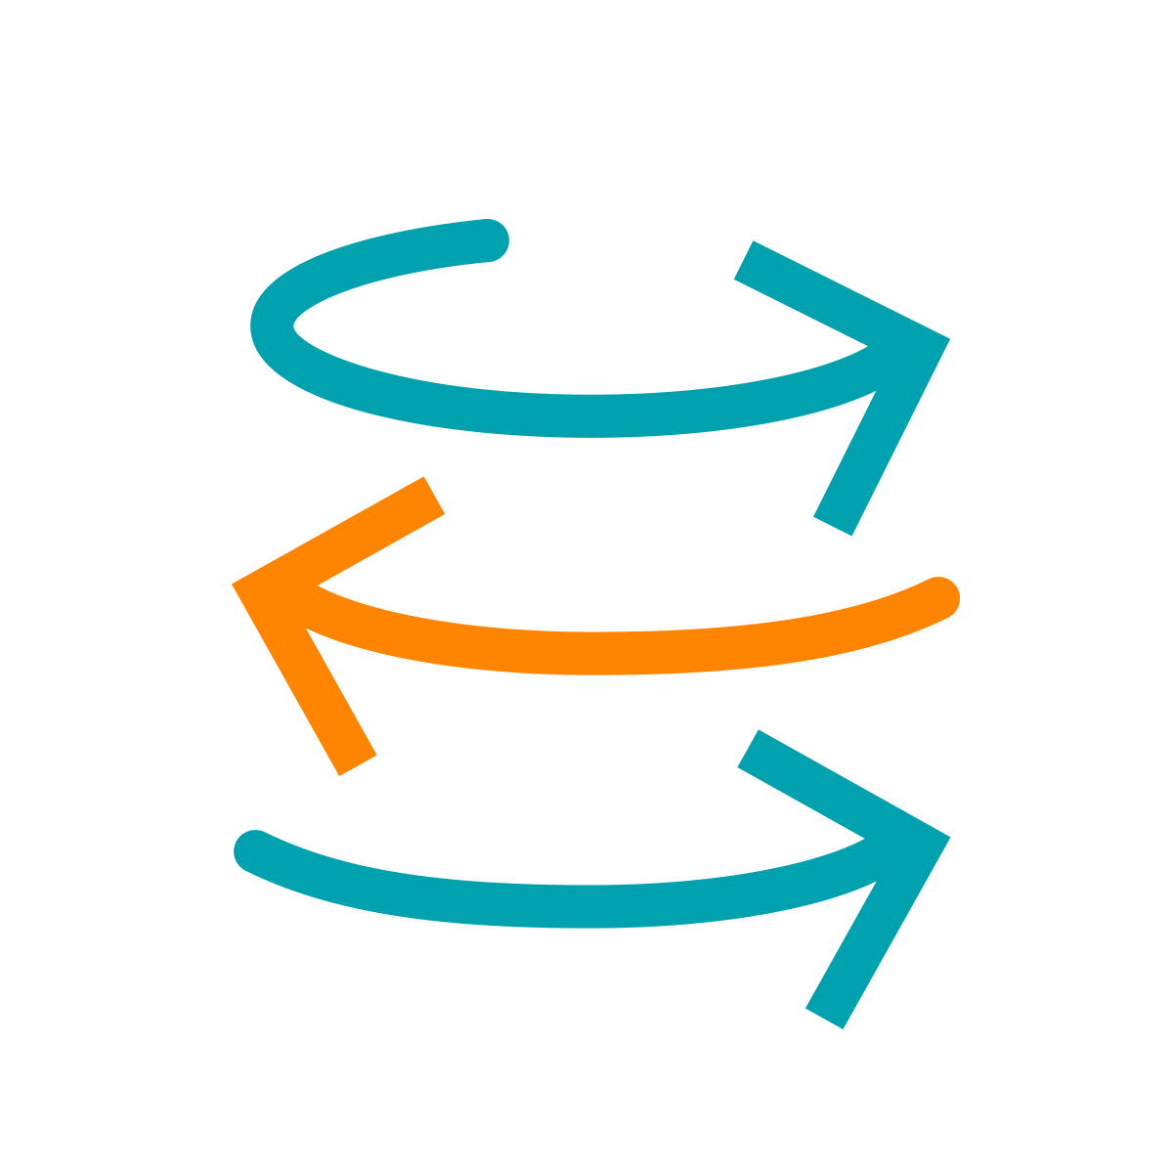
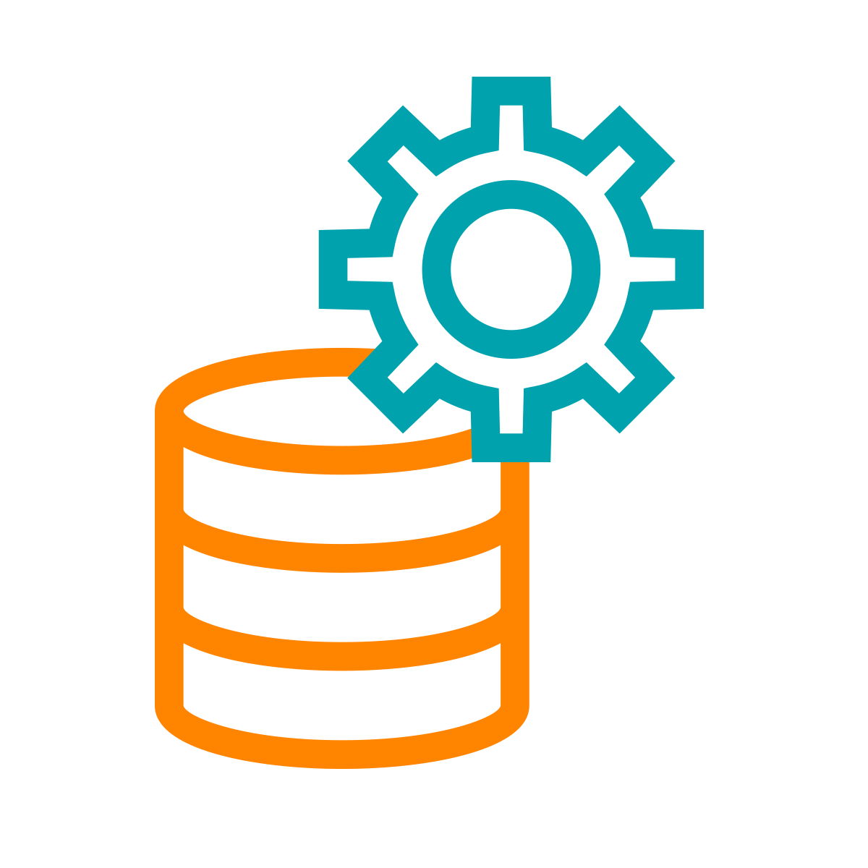
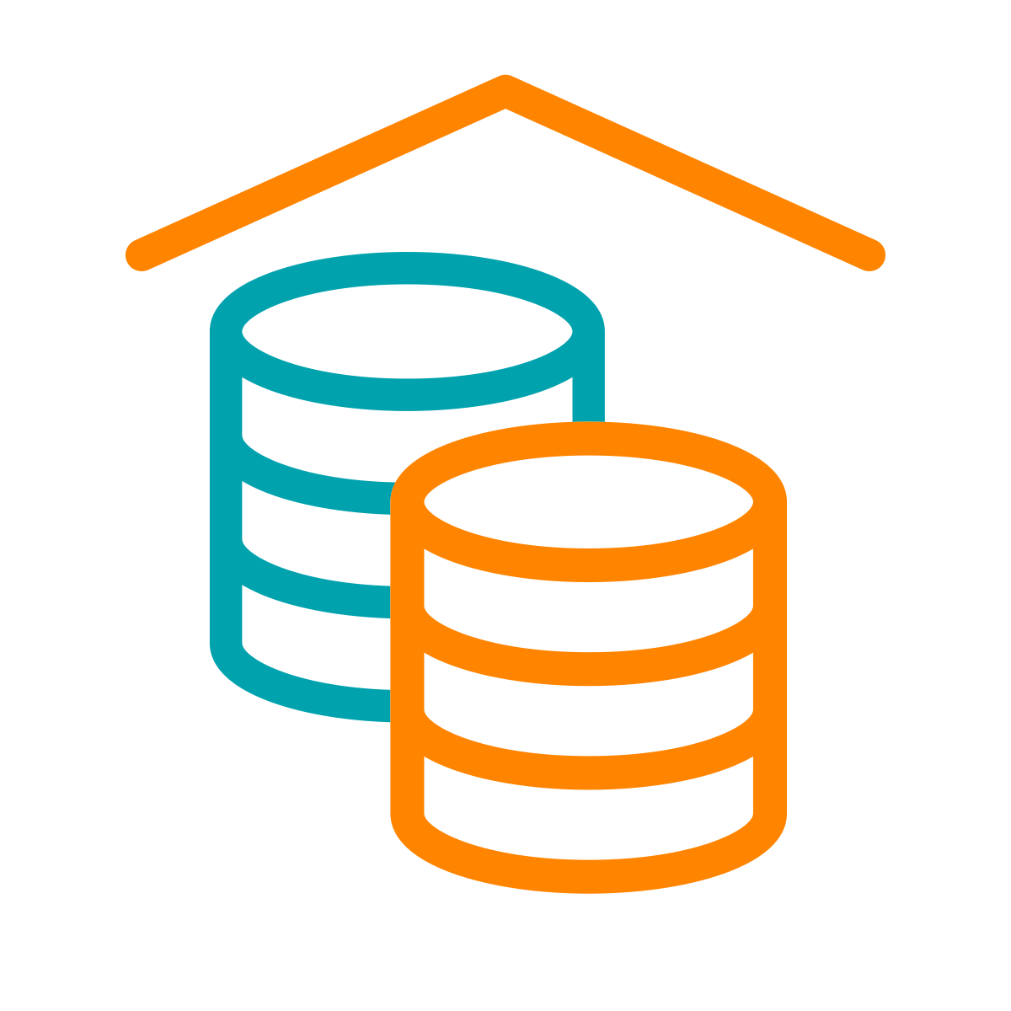
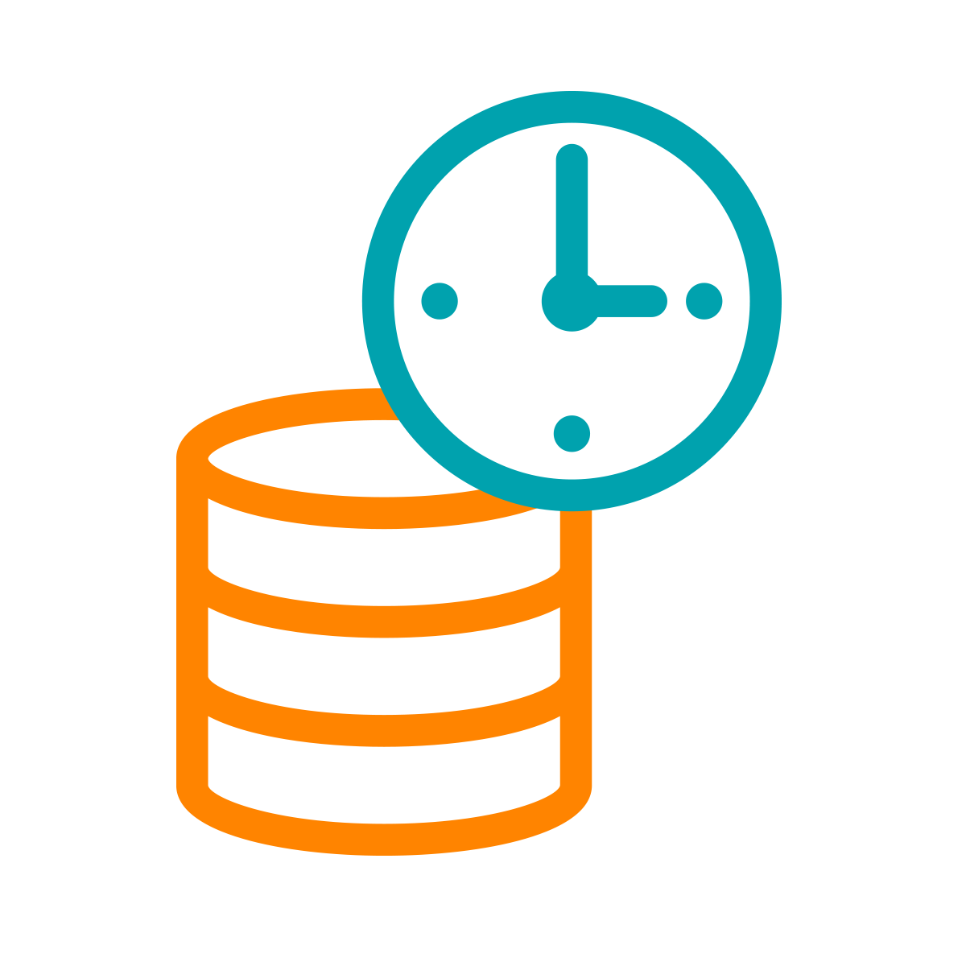
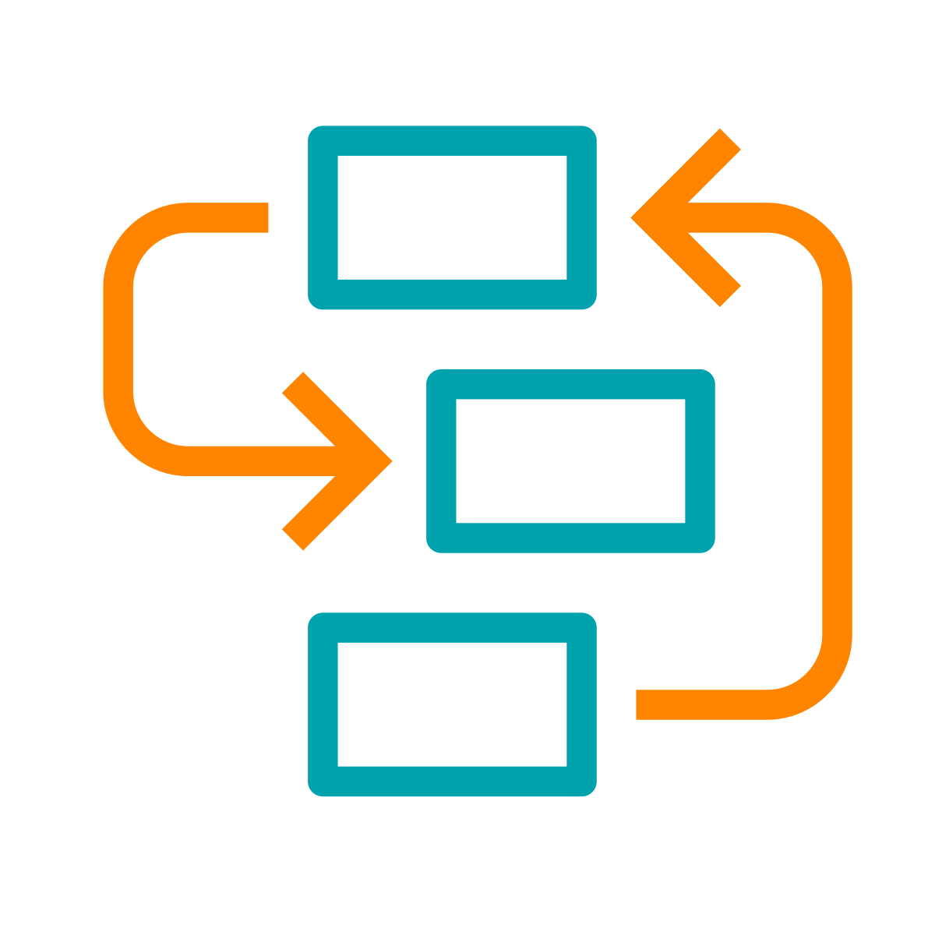
CDP PUBLIC CLOUD
CDP Public Cloud
Analytic Data Services
Ideal for new apps, bursty workloads and demanding users
Easier to operate, 10x faster
Auto scale, suspend and resume
Better analytics user experience, outperforms shadow IT
Data Services
MANAGEMENT CONSOLE
DATA CATALOG
REPLICATION MANAGER
WORKLOAD
MANAGER
Cloud-native architecture with containerized Experiences and Base cluster foundation
Admin and user experience is consistent across CDP Private & CDP Public for true hybrid cloud
DF
DE
DW
OD
ML
K8S Containers - EKS, AKS, etc.
Data Hub
Storage management and SDX for Analytic Experiences
Supports existing apps and traditional workloads with Data Hub
Data Hub offers cluster management for Flow, Streaming, Data Engineering, Data Warehouse & Operational Database
Data Hub
DATA
HUB
OBJECT STORE S3 | ADLS | CS
Virtual Servers
Notes:
With CDP Public Cloud you get a Cloud-native architecture with containerized Data Services and Base cluster foundation.
You also get a single pane of glass to manage the CDP Private & CDP Public for true hybrid cloud capabilities
Let’s take a closer look at CDP Public Cloud platform.
[CLICK]

Slide 21
KEY TECHNOLOGIES FOR THE DATA LIFECYCLE
Machine Learning
Collaborative ML workspaces for data scientists to develop, experiment and deploy models into production with secure, self-service enterprise data access
DataFlow & Streaming
Scalable, real-time streaming platform to ingest, curate, and analyze data with an easy no-code approach to developing sophisticated streaming applications easily
Data Engineering
Schedule, monitor, and debug data pipelines to streamline ETL processes quickly and securely with built-in job scheduling and troubleshooting
Data Warehouse
Deploy easy-to-use data warehouses with high performance SQL engines for teams of business analysts that need sub-second query response times on petabyte scale data
Data
Visualization
Curate fast, self-service dashboards, reports and charts to easily and quickly develop and share agile analytical insight across your business
Operational Database
High-performance NoSQL database with unparalleled scale and performance for business critical operational applications
Easily manage data clusters across the data lifecycle running Apache Spark, Hive, Impala, HBase, Phoenix, NiFi, Kafka, Flink, and more
Shared Data Experience
Security, governance and metadata technologies that reduce security risks and operational costs through central policy controls that are automatically enforced across analytics in public and private clouds
Data Hub

Slide 22
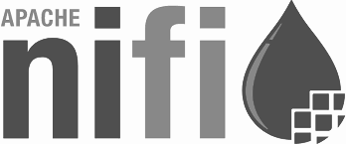

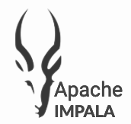
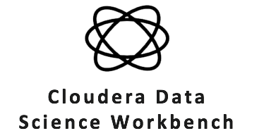
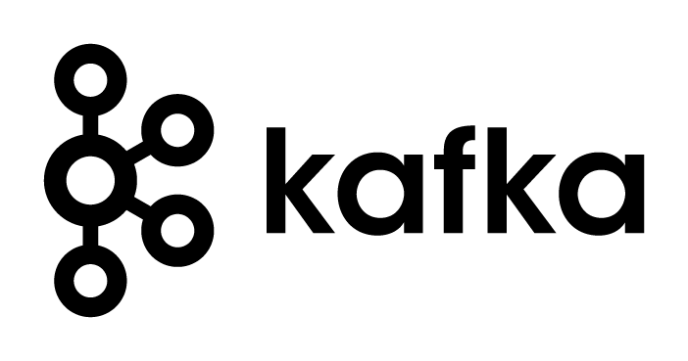
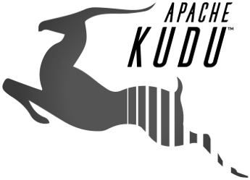
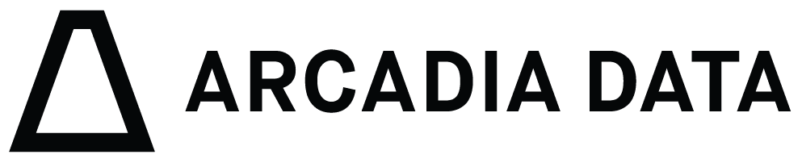
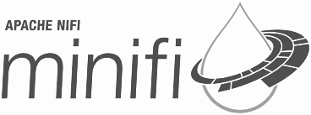
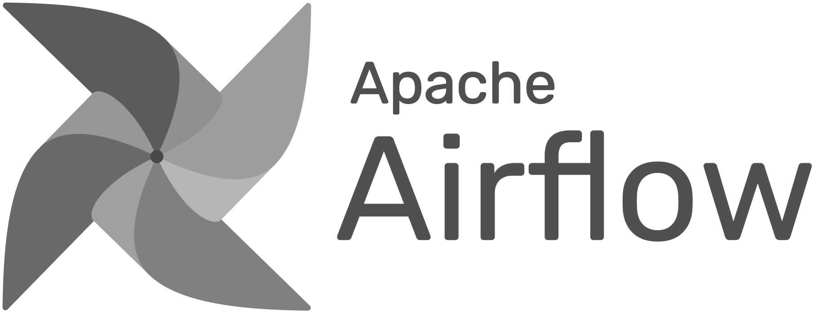
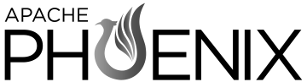
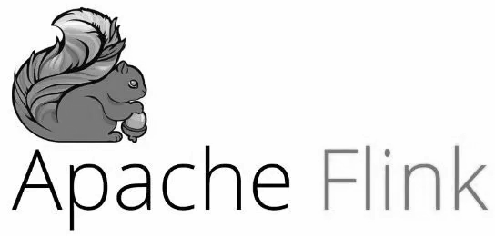

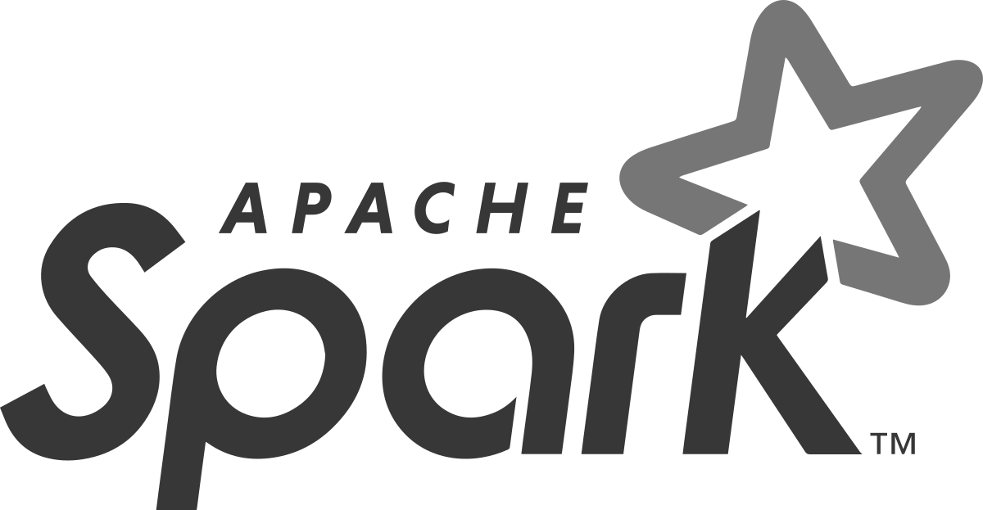

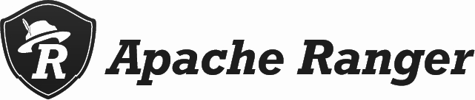
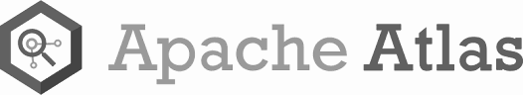
... A RUNTIME FOR THE ENTERPRISE DATA LIFECYCLE
What is the industry’s best enterprise-grade blend of data management framework?
Collect
Report
Predict
DATA ENGINEERING
OPERATIONAL DATABASE
02
04
Enrich
Serve
01
03
05
STREAMING & DATA FLOW
DATA WAREHOUSE
MACHINE LEARNING & AI
SECURITY | GOVERNANCE | LINEAGE | MANAGEMENT | AUTOMATION

Slide 23
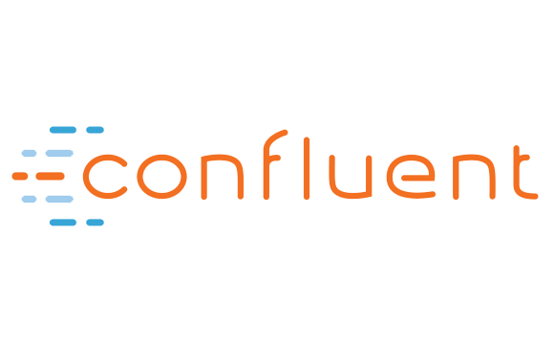
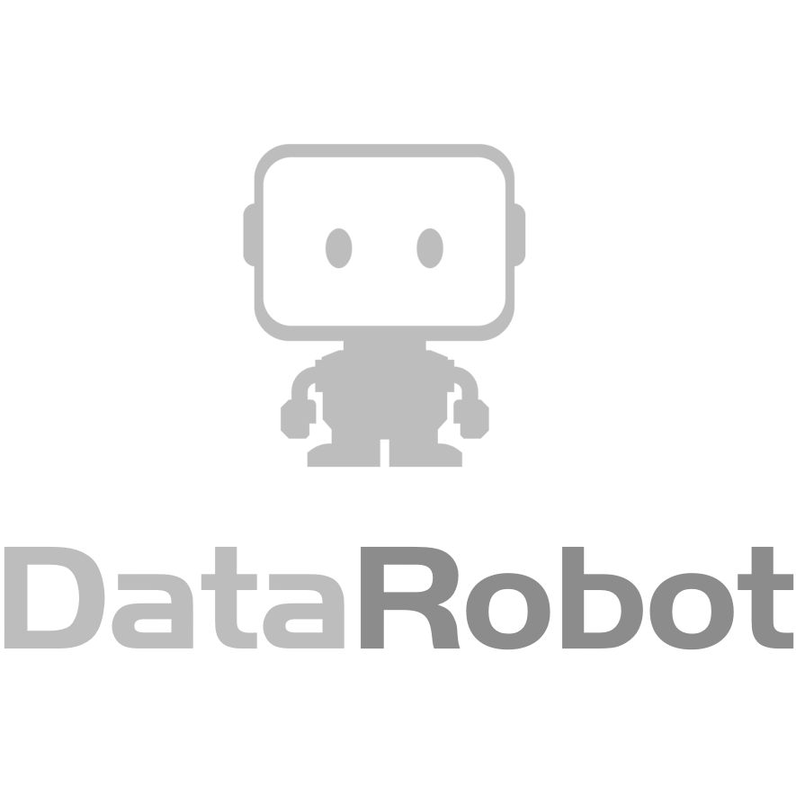


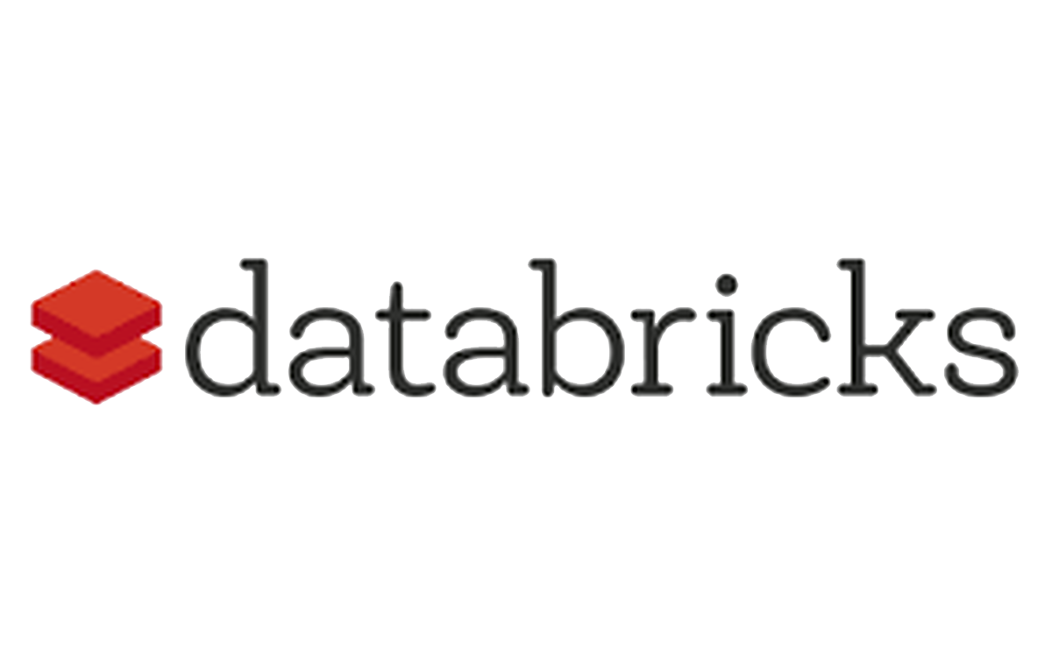
DATA LIFECYCLE USING "POINT SOLUTIONS"
DATA ENGINEERING
OPERATIONAL DATABASE
02
SQL
04
WORKBENCH
01
03
05
STREAMING & DATA FLOW
DATA WAREHOUSE
MACHINE LEARNING & AI
NoSQL
SECURITY | GOVERNANCE | LINEAGE | MANAGEMENT | AUTOMATION
Notes:
We manage, secure and automate the complete data and analytics lifecycle in any cloud or datacenter...

Slide 24
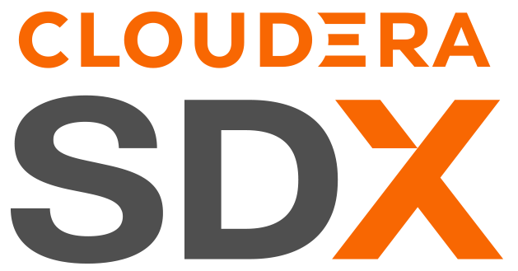
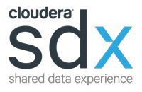
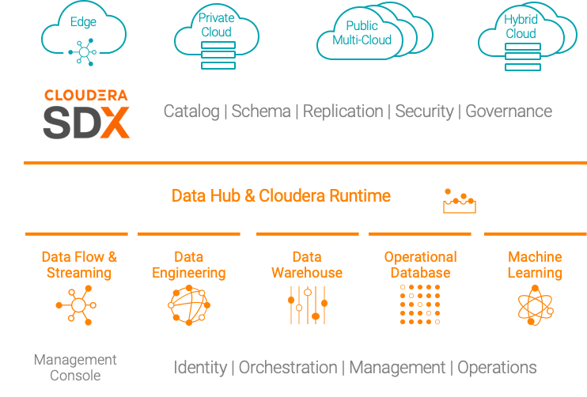
CONSISTENT SECURITY AND GOVERNANCE
Built for multi-functional analytics anywhere
Data Catalog: a comprehensive catalog of all data sets, spanning on-premises, cloud object stores, structured, unstructured, and semi-structured
Schema: automatic capture and storage of any and all schema and metadata definitions as they are used and created by platform workloads
Replication: deliver data as well as data policies there where the enterprise needs to work, with complete consistency and security
Security: role-based access control applied consistently across the platform. Includes full stack encryption and key management
Governance: enterprise-grade auditing, lineage, and governance capabilities applied across the platform with rich extensibility for partner integrations
Notes:
And SDX does just that as a critical and differentiating platform capability
Consistent security and governance as well as schema and data catalog service
So you can deploy to any infrastructure

Slide 25
COMPONENT ARCHITECTURE

Slide 26
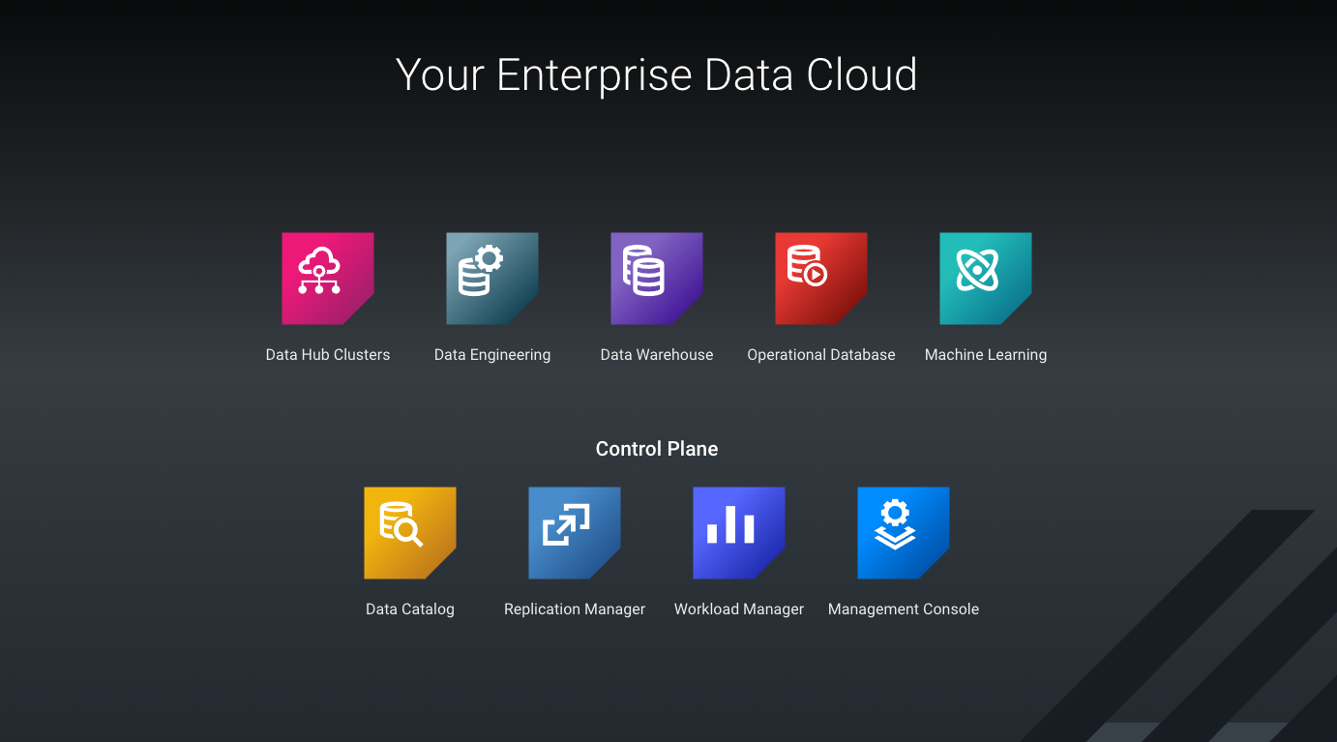
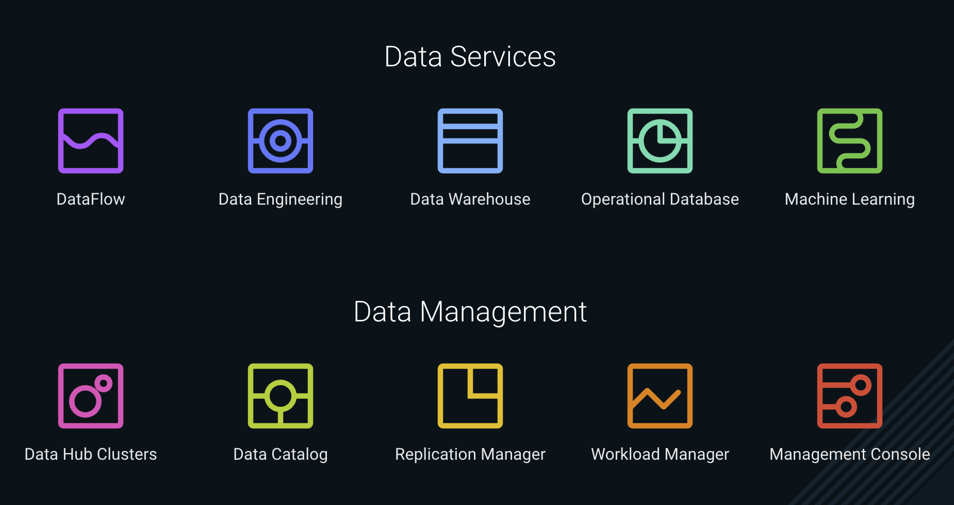
THE ENTERPRISE DATA CLOUD
COMPONENTS
New Data Services:
Data Flow
Data Engineering
Data Warehouse
Operational Database
Machine Learning
Traditional Platform Consumption:
Data Hub Clusters
Control Plane services:
Workload Manager
Replication Manager
Data Catalog
Management Console

Slide 27
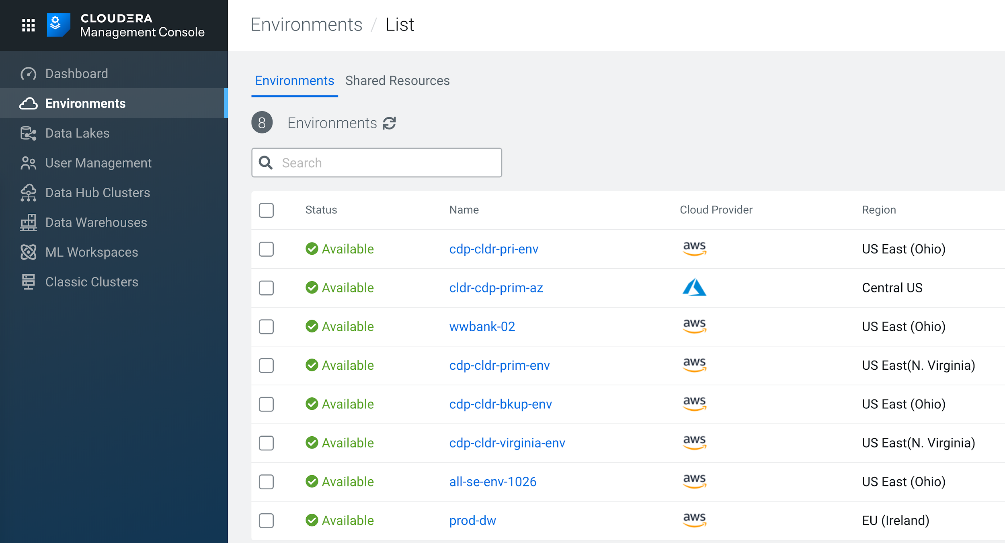
KEY CONCEPTS & COMPONENTS
ENVIRONMENTS
Environment
1 Template
1 Region
1 VPC
Multiple Roles/Buckets
Data Lake
SDX: Atlas, Ranger, Knox, IdBroker, CM
Associated with groups/users
1:1
Data Hub Clusters / Data Services
DH Clusters
CDF, CDE, CDW,COD,CML
1:N

Slide 28





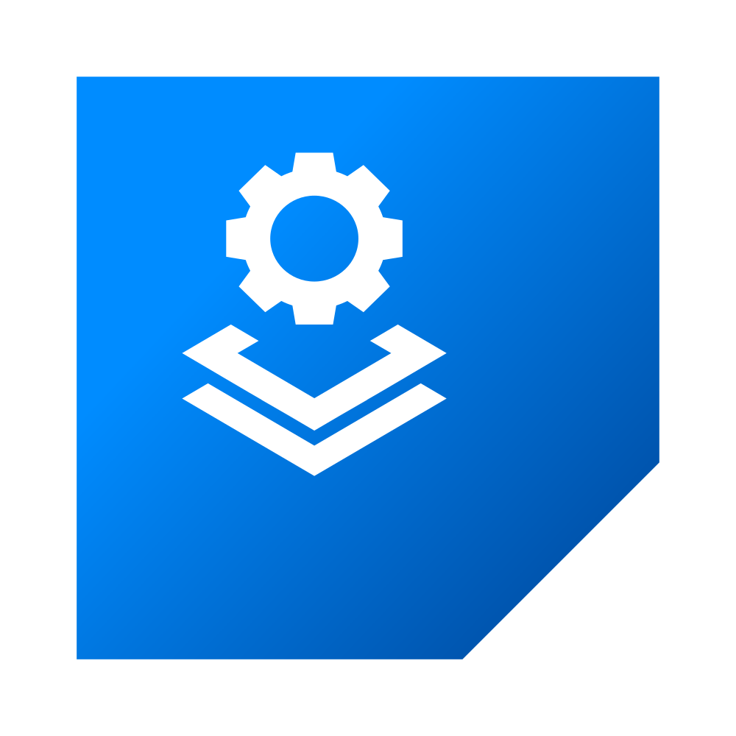
KEY CONCEPTS & COMPONENTS
Typical user flow
Step 3
They create data hub clusters for traditional workloads
Step 1
User connects to CDP with their enterprise identity
3
Atlas
Node 1
Node 2
Node 3
Node 1
Node 2
Node 3
Ranger
BI Team Cluster
ETL Team Cluster
1
2
Knox
IdBroker
Management Console
FreeIPA
4
CM
Enterprise IT
CDP Control Plane
HMS
Data Lake
Data Warehouse Experience
Machine Learning Experience
Step 2
They create an environment and data lake for their enterprise
Environment
Enterprise Cloud Resources (IAM, Network, VMs, Buckets, etc.)
Step 4
They create access points for containerized analytic experiences
Notes:
The first Step
So, The user or Admin first connects to the CDP Control Plane using their enterprise ID.
[CLICK]
Once you are on the CDP Control Plane
The Control Plane has common set of tools for management, workload analysis, data movement and data discovery across multiple environments
From here the Admin will create and environment and data lake.
[CLICK]
This where CDP creates resources in a customer environment.
There is a long running permanent cluster called the Data Lake that gets created here.
The Data Lake is a common set of Services within an Environment that are shared across multiple Clusters and Data Services.
This Cloudera SDX it has:
Security
Auditing
Governance
Data Discovery
Think of Data Lake as your persistent layer.
So Once you have your environment and data lake up an running, you’ll likely want compute services.
[CLICK]
For that you have Datahub Clusters
Data Hub Cluster are customizable environments that runs like a traditional Hadoop cluster, but is designed to leverage Cloud Storage.
You also have Data Services
[CLICK]
Data Services are container-based compute environments for specific purposes, like Machine Learning, Data Warehousing, Data Engineering or Data Flow.
Again, these compute service can come and go, but your data lake will alway be there with your data, meta data, data catalog, policies and so on.
Let’s take a look at what this looks like on specific clouds
[CLICK]

Slide 29
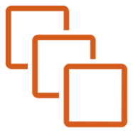


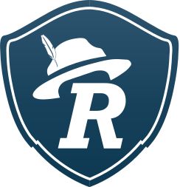
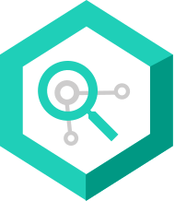

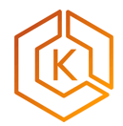













Customer AWS Account
CDP on AWS
FreeIPA Services
SDX Data Lake
Data Hub / COD
K N OX
High Level Architecture
KDC
Ranger
Cloudera Runtime (all services)
Features:
PaaS
Custom Templates
Manual Scaling
LDAP
Atlas
EC2
S3
In-built definitions
Cloudera Cloud
DNS
IDBroker
Data Warehouse
User
CA
Hive Metastore
Hive (w LLAP)
Features:
PaaS
Fast Auto Scaling
JDBC connectivity
Data Catalog
Cloudera Manager
EKS
S3
Impala
CLI
DLM
DAS & Hue
Replication Manager
Amazon EC2
BDR
Amazon EC2
Machine Learning
Web UI
Workload Analytics
ML Workbench
Features:
PaaS
Fast Auto Scaling
GPU support
SAML Federation
S3 Storage
EKS
S3
Spark
SDK
Identity Management
Amazon RDS
Python/R
ID Broker Mapping
Mgmt, Orchestration, & Monitoring Services
Data Engineering
S3 Storage
Spark
Features:
PaaS
Fast Auto Scaling
Job Management
Control Plane APIs
EKS
S3
Airflow
KNOX
Safari (perf-mon)
DataFlow
Cross Account Access IAM Role
NiFi
Features:
PaaS
Fast Auto Scaling
Flow Management
Amazon IAM
EKS
Serverless
S3
Zookeeper
Monitoring
Notes:
CDH -> CDP based on Cloudera BDR
HDP -> CDP based on Hortonworks DLM

Slide 30






Customer Azure Resource Group
CDP on Azure
FreeIPA Services
SDX Data Lake
Data Hub / COD
K N OX
KDC
Ranger
Cloudera Runtime (all services)
Features:
PaaS
Custom Templates
Manual Scaling
High Level Architecture
LDAP
Atlas
VMs
ADLS Gen2
In-built definitions
Cloudera Cloud
DNS
IDBroker
Data Warehouse
User
CA
Hive Metastore
Hive (w LLAP)
Features:
PaaS
Fast Auto Scaling
JDBC connectivity
Data Catalog
Cloudera Manager
Impala
AKS
ADLS Gen2
DAS & Hue
CLI
DLM
Replication Manager
VMs
BDR
VMs
Machine Learning
Web UI
Workload Analytics
ML Workbench
Features:
PaaS
Fast Auto Scaling
GPU support
SAML Federation
ADLS Gen2
AKS
ADLS Gen2
Spark
SDK
Identity Management
Python/R
ID Broker Mapping
PostgreSQL
Mgmt, Orchestration, & Monitoring Services
Data Engineering
ADLS Gen2
Spark
Features:
PaaS
Fast Auto Scaling
Job Management
Control Plane APIs
AKS
ADLS Gen2
Airflow
KNOX
Safari (perf-mon)
DataFlow
AAD App/w
Contributor Role
(Subscription or RG)
NiFi
Features:
PaaS
Fast Auto Scaling
Flow Management
Active Directory
Zookeeper
AKS
ADLS Gen2
Monitoring
Notes:
CDH -> CDP based on Cloudera BDR
HDP -> CDP based on Hortonworks DLM

Slide 31






Customer GCP Project
CDP on GCP
FreeIPA Services
SDX Data Lake
Data Hub / COD
K N OX
High Level Architecture
KDC
Ranger
Cloudera Runtime (all services)
Features:
PaaS
Custom Templates
Manual Scaling
LDAP
Atlas
Compute
Storage
In-built definitions
Cloudera Cloud
DNS
IDBroker
Data Warehouse
User
CA
Hive Metastore
Hive (w LLAP)
Features:
PaaS
Fast Auto Scaling
JDBC connectivity
Data Catalog
Cloudera Manager
Impala
DLM
GKE
Storage
DAS & Hue
CLI
Replication Manager
Compute
Machine Learning
BDR
Compute
Web UI
Workload Analytics
ML Workbench
Features:
PaaS
Fast Auto Scaling
GPU support
SAML Federation
Storage
GKE
Spark
SDK
Identity Management
Cloud SQL
Storage
Python/R
ID Broker Mapping
Mgmt, Orchestration, & Monitoring Services
Data Engineering
Storage
Spark
Features:
PaaS
Fast Auto Scaling
Job Management
Control Plane APIs
GKE
Airflow
Storage
Safari (perf-mon)
KNOX
DataFlow
Provisioning Service Account
NiFi
Features:
PaaS
Fast Auto Scaling
Flow Management
Cloud IAM
Zookeeper
GKE
Storage
Monitoring
Notes:
CDH -> CDP based on Cloudera BDR
HDP -> CDP based on Hortonworks DLM

Slide 32
CDP PRIVATE CLOUD
Notes:
Lets now go over CDP Private Cloud

Slide 33
CDP PRIVATE CLOUD
An enterprise data platform with next generation cloud-native hybrid data architecture, enabling on-premises deployments with the agility, flexibility and cost-efficiency of cloud architectures
Notes:
CDP Private Cloud is the On-premises enterprise data and analytics platform that has the agility and flexibility of public cloud, and all the control of the data center
[CLICK]

Slide 34

WHAT IS CDP PRIVATE CLOUD?
New set of data analytics applications
Featuring use-case optimized interfaces
Running on its own container cloud
Simplified deployment, with fast provisioning and efficient scaling
With access to a shared data lake
That is secured and governed
Notes:
With CDP Private Cloud containerized Data Services, like Data Engineering, Data Warehousing and Machine Learning.
It also supports HDFS and Ozone for Object storage.
It leverages the same Cloudera SDX for security and governance and Data lineage.
So what challenges were we trying to solve with CDP Private Cloud
[CLICK]

Slide 35







KEY CHALLENGES FOR IT / DATA PLATFORM TEAM
Platform Manager
Data Architect
Noisy neighbors | Complex upgrades | Lack of elasticity | Cluster sprawl | Time to value
A spike in demand for resources impacts other workloads running on a shared cluster. Can lead to missed SLAs. | Upgrading a cluster can take 6 months of planning to cater for the needs of different business workloads. | Cluster is rigid, with assigned compute and storage nodes for each workload. Hardware over-provisioned to cater for future need and is mostly idle. | New clusters are spun up for new business apps in order to avoid impacting existing workloads. This leads to data silos. | It takes weeks to months to provision resources to set up a cluster. LOBs instead deploy agile point solutions, resulting in shadow IT.
Notes:
First Noisy Neignbors
There goes Marketing team stalling the cluster, again!
Managing demand spikes is tough
Complex Upgrades
We are still on 2.x, you’ll have to wait to be able to use 3.x
Upgrading can take months to execute
Lack of Elasticity
We don’t use more than 40% of our infra, and yet some services often lack resources
Rigid clusters won’t allow you to share resources
Extended Onboarding Cycles
Your environment should be ready in 4-6 weeks, hopefully…
Co-location of storage & compute
We can’t grow compute independently of storage

Slide 36
ADVANTAGES OF CDP PRIVATE CLOUD
Meet SLAs with Predictable Performance
Improve Cost Efficiency
Rapid Time-to-Value
Workload isolation and better managed multi-tenancy minimizes spikes impacting critical workloads
Optimized resource utilization from disaggregated storage affords cost efficiencies across the cluster
Simplified provisioning and onboarding of new use-cases
Notes:
With CDP Private Cloud you get
Tenant isolation provided by the container cloud, enabling dedicated compute
You get Predictable performance to ensure you meet your application SLAs
You can optimize your resources to improve cost efficiency.
You get Elasticity to Auto-Scale & Auto-Suspend
You Use what you need, when you need it
You can Shift excess capacity according to demand
You can quickly on board new workloads to address new use cases to improve your time to value.

Slide 37
CDP DEMO

Slide 38
THANK YOU

Slide 39
OZONE Overview
THE MODERN BIG DATA OBJECT STORE

Slide 40
WHY A NEW BIG DATA STORAGE PLATFORM IS NEEDED
HDFS has reached its limits
Proprietary systems are not an option
On prem object stores don’t provide the required scale and performance
Name node Restarts take 60+ minutes
RPC calls are slowing
Huge Memory Needed
Per node density not keeping up with hardware vendors
HDFS and S3 are standards
Portability between On prem and cloud
Very few options in this space that have been designed for use at a big data scale

Slide 41
REQUIREMENTS:
BIG DATA STORAGE

Slide 42
BIG DATA STORAGE REQUIRES ...
Scale
API Compatibility
Performance
Can it Scale To 100’s PB, 1000’s of nodes and billions of objects
Does it support S3 API and Modern Architecture ?
Can it handle large workloads

Slide 43
… AND NATIVE INTEGRATION WITH BIG DATA WORKLOADS
Application
Security
Encryption
support separation and legacy applications
Is the data protected at rest and in-transit?
Support Kerberos and access control policy

Slide 44
INTRODUCING:
OZONE MODERN BIG DATA OBJECT STORE

Slide 45
INTRODUCING - APACHE OZONE
Ozone is a scalable, redundant, and Distributed Key Value Object Store.
Ozone is designed and optimized for Big Data workloads.
Ozone can scale up to billions of objects and work effectively in containerized environments like Yarn or Kubernetes.
Ozone is strongly consistent and provides the benefits of traditional HDFS and S3 Object Store
Scale to 1000’s of nodes with dense storage configurations
Apache Spark, Hive and YARN work without any code modifications by using OFS protocol
Reduce cost per TB using commodity hardware

Slide 46
Ozone Data Layout -
Ozone consists of volumes, buckets, and keys
Volumes are similar to user accounts. Only administrators can create or delete volumes.
Buckets are similar to Amazon S3 buckets. A bucket can contain any number of keys, but buckets cannot contain other buckets.
Keys are similar to files
Created using s3 client or HDFS/Ozone client
Full path to a created key may look like this - ‘/Volume1/bucket1a/application-1/instance-1/Key1’
If created using the Filesystem interface, the intermediate prefixes (application-1 & application-1/instance-1) are created as directories in the Ozone metadata store.
Essentially Ozone is an Hybrid file system that supports both key value store and hierarchical file system.
namespace
Volume1
S3V
Bucket1a
Bucket1b
Bucket2a
Bucket2b
Key 1
Key 2
Key 3
Key 4
Key 5

Slide 47

Ozone Interfaces

Slide 48
ARCHITECTURE

Slide 49
Ozone Building Blocks
Use proven technologies - don’t reinvent the wheel
Ozone separates namespace management and block space management; this helps ozone to scale much better
Ozone Manager (OM) – provides namespace management, built on RocksDB
Storage Container - Replication unit of Ozone, built on RocksDB
Storage Container Manager – Distributed container management layer
Apache RATIS - Implements RAFT an easily understandable consensus algorithm to manage replicated state – http://raft.github.io
Data is replicated between datanodes with the help of RAFT consensus algorithm
Hadoop security model and Hadoop RPC
Notes:
RAFT is an industry standard distributed consensus algorithm (an easier alternative to Paxos).

Slide 50

Architecture
Ozone Client

Slide 51

Ozone Building Blocks
Ozone separates namespace management and block space management
Namespace managed by Ozone Manager (OM) daemon.
Keeps only the working set in memory.
The block space is managed by Storage Container Manager (SCM).
Scales by not tracking individual data blocks. Instead it tracks containers* which are aggregations of blocks. Typical container size is 5GB.
By scaling namespace and block management independently, Ozone can scale to billions of files in a cluster.
* No relation to Linux or YARN containers.

Slide 52

Ozone Manager (Namespace)
Namespace
Ozone’s namespace is a collection of volumes
For each volume, the list of buckets and for each bucket the list of keys
OM maintains a list of volumes, buckets, and keys
Ozone Manager will use Apache Ratis(A Raft protocol implementation) to replicate Ozone Manager state. This will ensure High Availability for Ozone.
Notes:
Ozone Manager (OM) is the namespace manager for Ozone.
This means that when you want to write some data, you ask Ozone Manager for a block and Ozone Manager gives you a block and remembers that information. When you want to read that file back, you need to find the address of the block and Ozone Manager returns it you.
Ozone Manager also allows users to organize keys under a volume and bucket. Volumes and buckets are part of the namespace and managed by Ozone Manager.
Each ozone volume is the root of an independent namespace under OM. This is very different from HDFS which provides a single rooted file system.
Ozone’s namespace is a collection of volumes or is a forest instead of a single rooted tree as in HDFS. This property makes it easy to deploy multiple OMs for scaling.

Slide 53

Storage Container Management
Storage container manager acts as the
Cluster manager
Certificate authority
Block manager
Replica manager
SCM allocates blocks and assigns them to data nodes.
Clients read and write these blocks directly.
SCM keeps track of all the block replicas.
Notes:
If there is a loss of data node or a disk, SCM detects it and instructs data nodes make copies of the missing blocks to ensure high availability.
SCM’s Ceritificate authority is in charge of issuing identity certificates for each and every service in the cluster. This certificate infrastructure makes it easy to enable mTLS at network layer and the block token infrastructure depends on this certificate infrastructure.
SCM is in charge of creating an Ozone cluster. When an SCM is booted up via init command, SCM creates the cluster identity and root certificates needed for the SCM certificate authority. SCM manages the life cycle of a data node in the cluster.

Slide 54

Storage Container
A collection of blocks, default size is 5GB.
Unit of replication
Solves the block report scale issue
Replicas synced via RAFT consensus protocol.
Stored on DataNodes
Managed by the Storage Container Manager
Equivalent to the HDFS block manager

Slide 55


Slide 56


Slide 57





Ozone - Multiple Protocol Support
S3 browser
Kube container
s3://
s3://
ComputeX
S3 Gateway
HttpFs
Recon
Ozone client
ofs://
s3cmd
S3 Gateway
hdfs://
aws s3 cli
SCM
S3 Ingest
OM
Load Balancer
Ozone client
(viewHDFS)
boto3
S3 Gateway
DN
DN
DN
DN
DN
s3://
Ozone client

Slide 58


Oz
Ozone S3 - User operation internals
S3 Gateway
Ozone Manager
Datanode
Ranger
Ozone Client
Datanode
Ozone
Datanode(s)
Create S3 secret
S3 secret
created
Set ACL
LDAP user
S3 secret
Admin
Signed with s3 secret
Create bucket
Create S3 token
Check ACLs
Put object
Create S3 token
Bucket created
Data Scientist
Create Key
Check ACLs
Key
Created
Block token(s)
S3 Client
Establish connection and stream data

Slide 59

Ozone Dense Data Nodes
S3 browser
Adhoc Queries
s3://
ofs://
ComputeX
Apache Ozone
ofs://
s3
OM
SCM
s3a://
ofs
Jobs
Client
DN
400TB
DN
400TB
DN
400TB
o3fs
s3://

Slide 60
CDP PRIVATE CLOUD BASE WITH OZONE + EXPERIENCES
Control Plane
Data Catalog
Experiences
PvC Experiences
Workload Manager
Machine Learning
Data Warehouse
Data Engineering
Replication Manager
Experiences Compute Service
OFS (HCFS API - Native )
S3 API
WORKLOADS
Hive/Spark/Impala/S3
SDX
(Ranger, Atlas, Kerberos, Encryption, Security)
CLOUDERA MANAGER
YARN / YQM
PvC Base
Ozone S3 Gateway
HttpFs
Recon
OZONE
Ozone S3 Gateway
Ozone Manager
SCM
Ozone S3 Gateway
DN
DN
DN
DN
DN
Dense datanodes (400 TB each)
Notes:
What isolation / multi-tenancy issues are you running into today
Upgrade process
How do you manage capacity in the cluster

Slide 61


Ozone + HDFS
OZone + HDFS Side by Side
Co-exist with HDFS in the same cluster
Segregated storage nodes or shared storage nodes with segregated volumes
Seamless application integration with HDFS (common core-site.xml)
Unified namespace view with ViewHDFS

Slide 62
Deployment Layout
Deployment Requirements
Ozone can be installed alongside HDFS in a CDP cluster and that is the only deployment option supported today.
Ozone Manager
No. of instances: ( 3)
One SSD per instance
Cannot be co-located with SCM or Datanode
Storage Container Manager
No. of instances: (1,3)
One SSD per instance
Cannot be co-located with OM or Datanode
Recon
No. of instances: (1)
One SSD per instance
Can be co-located with any other component
Datanodes
No. of instances: (1 - ∞)
One/Two SSDs per instance for storing metadata (Based on desired density, Ozone is designed for denser DNs e.g.: 24 * 16TB HDD ~ 4 times of HDFS)Can be co-located with HDFS Datanode (not recommended)
S3 Gateway
No. of instances: (1 - ∞)
Can be co-located with any other component
Prometheus
No. of instances: (0 - 1)
Support for Prometheus

Slide 63
Deployment Layout
Deployment Requirements
Types of Nodes | Number of nodes | Min Requirements Compute | Storage Requirements
Management (OM) | 3 | 128GB RAM, 32 cores | 2 NVME - mirrored (2TB) for Metadata 2 NVME - mirrored (2TB) for HA Logs
Management (SCM) (can be co-located with OM) | 3 | 128GB RAM, 32 cores | 2 NVME - mirrored (2TB) for Metadata 2 NVME - mirrored (2TB) for HA logs
Data Nodes ( + S3 Gateway) | N (Min - 3) | 128GB RAM, 32 cores 2 x 25G Network | 1 SSD - For Replication logs N Disks - ( 24 x 16 or 48 x 8 or 48 x 16 or 16 x 16)
Management (RECON) | 1 | 128GB RAM, 32 cores | 2 NVME - mirrored (2TB) for Metadata
Notes:
https://docs.cloudera.com/cdp-private-cloud-upgrade/latest/release-guide/topics/cdpdc-ozone.html
40+ GBps Full Duplex Strongly Recommended but 25GBps Bonded Full Duplex is OK

Slide 64
Deployment Layout
Node Type | Service | Storage | Memory | CPU Cores | Network
Master Nodes (3 replicas) | Ozone Manager (3x) | 2 * 2TB NVMe SSD | Minimum 256 GB Host Memory 31 GB - OM Heap 31 GB - SCM Heap | 32 | 100 GBps/ 10 GBps 40+ GBps
 | Storage Container Manager (3x) | 2 * 1TB NVMe or SATA SSD
Worker Nodes (Up to 200) | Ozone Datanode | 1 * 2TB SATA or NVMe SSD (replication logs) 24 * 16TB HDDs; or 48 * 8TB HDDs (user data) | Minimum 128 GB Host Memory DN Java Heap - 16 GB DN off-heap - 15 GB 31 GB - S3G Heap | 32
 | S3 Gateway | NA | 31 GB | 24
Admin Dashboard (1 replica) | Recon Server | 1 * 1TB SATA or NVMe SSD | 32 GB - Host memory 16 GB - Recon Heap | 16
Notes:
https://docs.cloudera.com/cdp-private-cloud-upgrade/latest/release-guide/topics/cdpdc-ozone.html
40+ GBps Full Duplex Strongly Recommended but 25GBps Bonded Full Duplex is OK

Slide 65
Security

Slide 66

Security
KERBEROS and Token support
All Ozone services (OM/SCM/DN/Recon/S3G) support Kerberos
OM supports delegation token and block token
S3G supports S3 secret (token)

Slide 67
Security
Encryption and TLS
Ozone supports both over the wire and at-rest data encryption.
At-Rest data encryption can be enabled at Ozone bucket level when the bucket is created.
Each object created under the encrypted bucket are protected by a different object encryption key.
Both bucket encryption key and object encryption key are managed by Apache Ranger KMS with ACL support.
Over the wire data protection via TLS for Ozone can be enabled by setting ozone.grpc.tls.enabled=true.

Slide 68
Ranger
How does Ranger work with Ozone
Ozone is fully integrated with Apache Ranger.
Ozone support pluggable authorization model
Ranger Ozone authorizer plugin is enabled by default in CDP. It authorizes all Ozone volume/bucket/key operations based on policies defined by Ranger admin UI.
Ranger audits all ozone operations.

Slide 69

Ranger
Ranger Ozone Integration workflow
Notes:
Admin user sets up policies for Ozone users (1 and 2).
Ozone users access Ozone subject to Ranger policies defined (3, 4 and 5).

Slide 70

Ranger
How to use Ranger with Ozone
Ranger Ozone Authorizer enabled with CM
Under the hood (ozone-site.xml)
ozone.acl.enabled = true
ozone.acl.authorizer.class = org.apache.ranger.authorization.ozone.authorizer.RangerOzoneAuthorizer

Slide 71

Ranger Policies for Ozone Service

Slide 72

Adding New Ranger Policies for Ozone Service

Slide 73
Spark, Hive and Impala

Slide 74
Spark Jobs
How to run Spark with Ozone
Ozone support with Cloudera Machine Learning(in short CML) is available from Private Cloud 1.0 and CDP DC 7.1.3 release.
Prerequisites:
CDP Base 7.1.3 Cluster.
Provisioned CML workspace
Prerequisites:
CDP DC 7.1.3 Base Cluster.
Provisioned CML workspace
Prerequisites:
CDP DC 7.1.3 Base Cluster.
Provisioned CML workspace
Notes:
This does not cover details about installation/setup of PVC.

Slide 75

Create project to run Spark Jobs
Here, we have selected Template
PySpark which has few example
spark programs.

Slide 76

Prerequisite steps before running spark program
Hadoop Authentication
Create bucket/volume and providing permissions.
Notes:
Hadoop Authentication: Upload KeyTab/login with principal/password.
Create volume/bucket needs to be done by login to base cluster.
Permissions: When ranger is enabled, provide appropriate permissions to volume/bucket

Slide 77


Launch Session and run spark job
Notes:
In the word count program, we have uploaded data to the volume/bucket we have created in ozone and using this data to run spark for wordcount.
Like this there are multiple templates, they all can be run on ozone just changing their data path point to ozone.

Slide 78
Impala and Hive
How to run Impala/ Hive with Ozone
Ozone support with Cloudera Data Warehouse (DWX) is available from Private Cloud 1.0 and CDP DC 7.1.3 release.
Prerequisites:
CDP Base 7.1.3 Cluster.
Provisioned Data Warehouse
Prerequisites:
CDP DC 7.1.3 Base Cluster.
Provisioned CML workspace
Prerequisites:
CDP DC 7.1.3 Base Cluster.
Provisioned CML workspace

Slide 79

Create Database Catalog in DWX
Create a Database Catalog.
Edit the Catalog settings - update hive.metastore.warehouse.dir and hive.metastore.warehouse.external.dir settings to point to an Ozone location (o3fs path).

Slide 80

How to run Impala with Ozone
Create an Impala Virtual Warehouse (VW) belonging to previously created DB Catalog.
Open Hue Editor.
Databases and Managed Tables created here will be stored in Ozone.
Notes:
Hue Editor can be opened using the “Open Hue” option on the upper right corner of the Virtual Warehouse instance.

Slide 81

How to run Hive with Ozone
Create a Hive Virtual Warehouse (VW) belonging to previously created DB Catalog.
Open DAS Web UI.
Databases and Tables created here will be stored in Ozone.
Notes:
Since underlying Hive Metastore’s warehouse location is pointing to Ozone, all the (managed) table’s data will be stored in Ozone by default.

Slide 82
APPENDIX

Slide 83
Apache Ozone
Strong Open Source Community
Community Adoption and Participation
Tencent at Scale - 1000 nodes and commit
Bloomberg - Contributor
Target - Contributor
Ecosystem Partners
Reference architecture from Cisco, Dell and HP
150 Committers and developers
Cloudera GTM
Private Cloud Offering
Customer Adoption Programs
Reference Architecture and White papers

Slide 84
USE CASES

Slide 85
Customer List
Primary Use cases
Customers deploying applications that use S3 API
Consolidate cluster into dense nodes, supports upto 400TB per node
PVC customers interested in separating compute and storage
Customers interested in deploying Hybrid Cloud architecture
Customers running into HDFS scale limits
Customers who would like to put historical data in S3 and use once a while

Slide 86




USE CASE #1 – OBJECT STORE FOR HIVE/IMPALA OR SPARK
Business Benefits
CDP Private Cloud Experiences
CDP Private Cloud Base cluster
COMPUTE
Easy deployment of cloud developed applications with S3
Single platform for AI / ML / GPU workloads
Minimizes data movement between platforms
SPARK
DATA SCIENCE
DATA WAREHOUSE
HIVE/IMPALA
KAFKA / NIFI
HCFS API - ofs://
Operational Benefits
S3 API
SDX
Single storage for big data analytics and S3 workloads
Easier administration with single pane of glass
Single operations team
S3 Applications
OZONE STORAGE

Slide 87
USE CASE #2 CONSOLIDATE SMALL TENANTS
CDP Private Cloud
Target Use Cases
Consolidate multiple small clusters on prem
Consolidate to dense storage nodes, replace 100TB nodes with 400TB storage nodes
Replace external object store for archival data with a single storage system
Scale upto 10 Billion objects
Small on prem
CDH / HDP clusters
Containers (OpenShift)
Migrate small tenants
T1
T2
T3
T4
Physical Servers
Experiences
Physical Servers
Small CDH / HDP clusters
Physical Servers
Small CDH / HDP clusters
Physical Servers
Small CDH / HDP clusters
Physical Servers
Small CDH / HDP clusters
COMPUTE
METADATA
Consolidate data silos
Physical Servers
STORAGE
SDX
Storage ( Ozone)
400TB
Notes:
Running many smaller cluster is inefficient
But that’s what quite a few customers do
Management overheads, data duplication, frustrated end users waiting for IT to spin up the next one. Shadow IT
With PVC, we can consolidate them
Engineering owner:
One copy of the data, platform, security. Single source of truth. Better hw utilization
Self service for data/analytics for ML/BI tenants

Slide 88
USE CASE #3: DISAG COMPUTE AND STORAGE
T5
T6
T7
T8
Containers / Kubernetes
CDP Private Cloud Experiences
Compute Experiences
Use Cases
Supports CDP Experiences out of the box
Upgrade and manage storage and compute separately
Separate compute experiences
Separate compute and storage by consolidating SDX / storage layer into a single data lake
Physical Servers
T1
T2
T3
T4
Compute Workloads
CDP Data Center
Cluster
SDX
Storage - Ozone
Notes:
Play 2: you can put it two ways
Eject the noisy neighbours
Or offer VIP treatment. Actually prefer that one
Here engineering or platform owners suffer from missed SLAs. They can meet them with PVC
As well as flexibly use their hw
End users no longer suffer from slowdowns
Performance is consistent, whatever they or their neighbours throw at it

Slide 89
USE CASE #4 – MODERN ARCH AND STANDARDS
Use Cases
CDP Private Cloud on Prem
Customers want to adopt S3 as the modern standard or architecture
Enable easy integration with various workloads
Use a single storage interface for modern and big data applications
CDP Private Cloud Experiences cluster
BI Analysts
Data Scientists
CDP Public Cloud on AWS
BI Analysts
Data Scientists
CUSTOM DATA WAREHOUSES
CUSTOM ML WORKSPACES
Traditional Compute
CDP Private Cloud Base cluster
CUSTOM DATA WAREHOUSES
CUSTOM ML WORKSPACES
SDX
SDX
CDH / HDP
OZONE - S3
S3

Slide 90

USE CASE #5 – HDFS SCALE LIMITS
Business Benefits
CDP Private Cloud Base cluster
CDP Private Cloud Base cluster
COMPUTE
COMPUTE
Designed to handle real time, streaming and batch workloads.
Increased scalability
No application change or porting needed
SPARK
SPARK
HIVE/IMPALA
HIVE/IMPALA
KAFKA / NIFI
KAFKA / NIFI
Operational Benefits
OTHER WORKLOADS
OTHER WORKLOADS
Reduced operational costs with decreased maintenance efforts.
No extended efforts.
Co-locate with HDFS with easy migration.
SDX
SDX
HDFS STORAGE
(300M FILES)
OZONE STORAGE
(2 BILLION Objects)
X

Slide 91



USE CASE #6 – HDFS NAMENODE MANAGEMENT
Business Benefits
CDP Private Cloud Base cluster
CDP Private Cloud Base cluster
Designed to scale linearly and quicker recovery during restarts
Reduces number of control plane nodes and services
COMPUTE
COMPUTE
SPARK
SPARK
HIVE/IMPALA
HIVE/IMPALA
Operational Benefits
KAFKA / NIFI
KAFKA / NIFI
Reduced operational costs with less maintenance efforts.
Co-locate with HDFS
Scale out architecture
RocksDB gives better performance and availability
Minimize performance issues due to Java GC
SDX
SDX
HDFS STORAGE
NameNode Restart
OZONE STORAGE

Slide 92
DISASTER RECOVERY
Use Cases
CDP Private Cloud on Prem
CDP Private Cloud on Prem
Consolidate into a single DR cluster
Use Ozone as the DR cluster on a different data center
CDP Private Cloud Experiences cluster
CDP Private Cloud Experiences cluster
BI Analysts
Data Scientists
BI Analysts
Data Scientists
CUSTOM DATA WAREHOUSES
CUSTOM ML WORKSPACES
CUSTOM DATA WAREHOUSES
CUSTOM ML WORKSPACES
Traditional Compute
Traditional Compute
CDP Private Cloud Base cluster ( 1 - n)
CDP Private Cloud Base cluster
SDX
SDX
HDFS / OZONE - S3
OZONE - S3

Slide 93
Benchmarks

Slide 94

OZONE PERFORMANCE
TPCDS: https://blog.cloudera.com/benchmarking-ozone-clouderas-next-generation-storage-for-cdp/
Startup time < 30 seconds
Tested with 2 billion objects
System takes advantage of SSD / NVMe
4K keys per second sustained throughput, tested up to a billion inserts.

Slide 95


OZONE BILLION OBJECT TEST
We loaded a billion objects in an Ozone cluster
11 Node cluster, 9 Datanodes, 3 data pipelines
Objectives
Throughput steadiness when cluster is heavily loaded
Stress the data io write path
Demonstrate scalability / stability

Slide 96
S3 Performance summary
Hardware summary:
Each node has network bandwidth of approx 4GiBps
48 Spinning Drives per datanode
16 Datanodes and 4 nodes for SCM, OM and Recon.
OM, SCM and Recon on SSD
Datanode raft log on SSD
Pure GET performance limited by either network bandwidth on the client or the total network bandwidth for datanodes (objects > 20 MB)
Initial mixed load testing indicates, network utilization is high and performance is capped by network.
S3 API | Datanodes | Clients | BW Observed (GiB) | Max Client BW (GiB) | Max Server BW (GiB)
Get | 8 | 8 | 15 | 32 | 16
Get | 16 | 4 | 14 | 16 | 32

